Slide 1
Interrogating how information (re)produces systemic barriers within LGBTQ+ communities to inform global LIS education
Vanessa L. Kitzie
@vkitzie
Travis L. Wagner
@trlwagner
A. Nick Vera
@nickvera22
Valerie Lookingbill
@valerielooking1
Notes:
Nick
Research funded by a three-year IMLS early career research grant

Slide 2
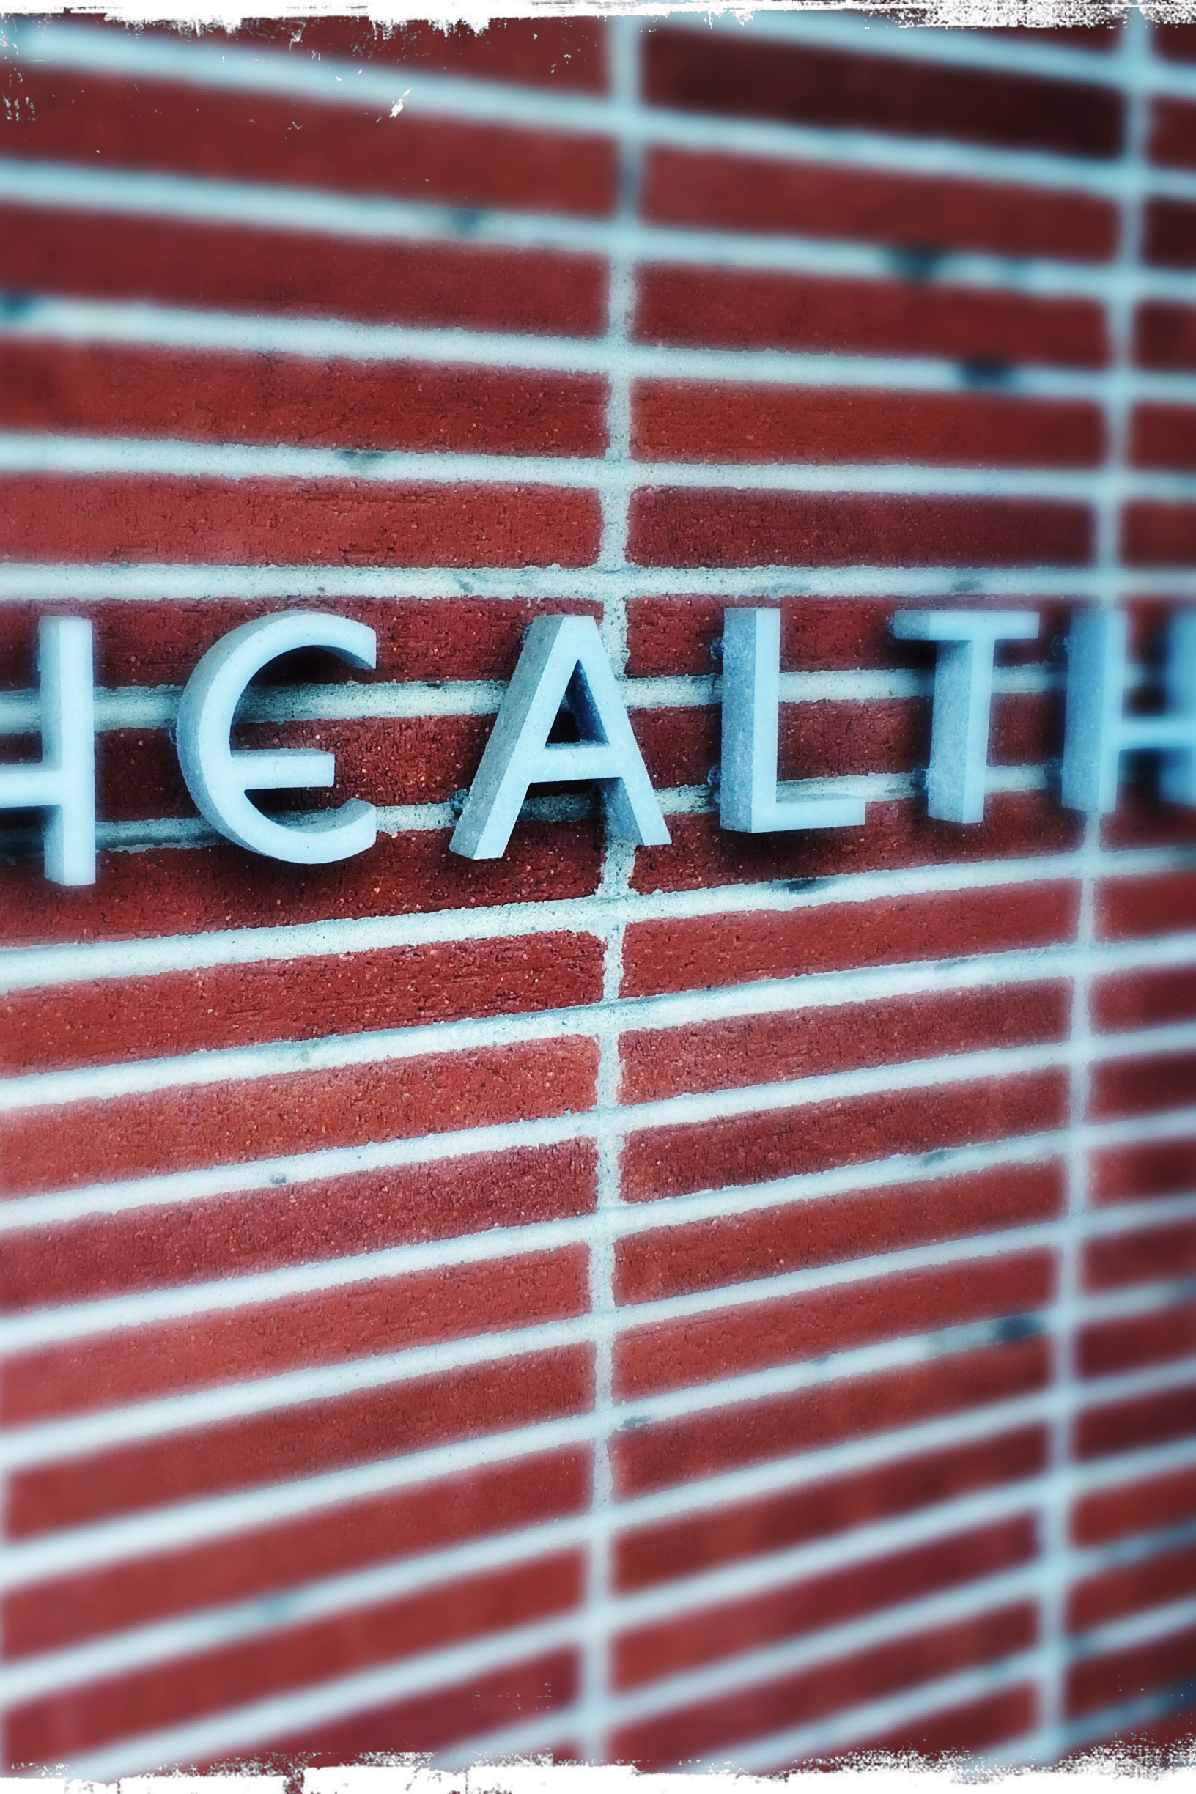
Background
LGBTQ+ populations face significant health challenges (HealthyPeople, 2019)
Challenges exacerbated in South (Matthews & Lee, 2014; Williams Institute, 2019)
Informational barriers (Morris & Hawkins, 2016; Romanelli & Hudson, 2017)
Notes:
Nick
LGBTQ+ people face health challenges compared to heterosexual and cisgender peers
Challenges are produced by social and structural factors such as legal discrimination and access to health services
Factors produce health disparities
Can be at LGBTQ+ level
E.g., LGBTQ+ populations have highest rates of tobacco, alcohol, and other drug use than non-LGBTQ+.
Can be specific to certain groups
E.g., transgender POC have higher rates of victimization as compared to LGBTQ+ and non-LGBTQ+
Health challenges enhanced in South, where LGBTQ+ people experience greater discrimination, more isolation
In SC LGBTQ+ people have:
Heightened economic instability
Unemployment
Lack of health insurance
…. As compared to national averages
Also experience enhanced discrimination due to LGBTQ+ identity
An relatively unaddressed factor contributing to LGBTQ+ health challenges are informational barriers, such as:
Difficulty learning about healthcare needs
Navigating healthcare system
Addressing barriers to care

Slide 3
Today’s Presentation
Reports empirical findings from research examining health information practices of SC LGBTQ+ communities
Leverages findings into implications for re-framing LIS education, specifically health librarianship
Notes:
Nick
Examines health information practices of SC LGBTQ+ communities with focus on how sociocultural factors shape these practices
Through presentation of our research seeking a reframing of LIS education focused on communities, in particular health librarianship

Slide 4
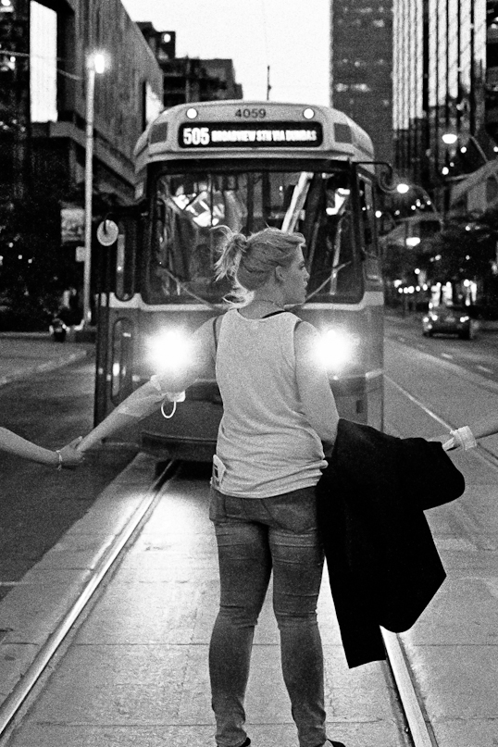
Theoretical Orientations
Social justice as metatheoretical approach (Rioux, 2010, p. 13)
Information practices as conceptual approach (Savolainen, 2007, 2008)
  Aligns with population health (Marmot & Wilkinson, 2005) & resilience (Colpitts & Gahagan, 2016) approaches
Notes:
Nick
Two theoretical orientations guiding our work: social justice and information practices
Social justice
Works for a society where people are treated fairly and have an equal share in societal benefits
Two key assumptions guiding theorizing:
“People perceive reality and information in different ways, often within cultural or life-world contexts”
“The provision of information services is an inherently powerful activity”
Information practices complimentary to social justice approach in attending to cultural and life-world contexts
Frames acting in response to social and structural barriers
Aligns with population health and resilience approaches assessing social and structural determinants of health, rather than rooting disparities within the individual

Slide 5
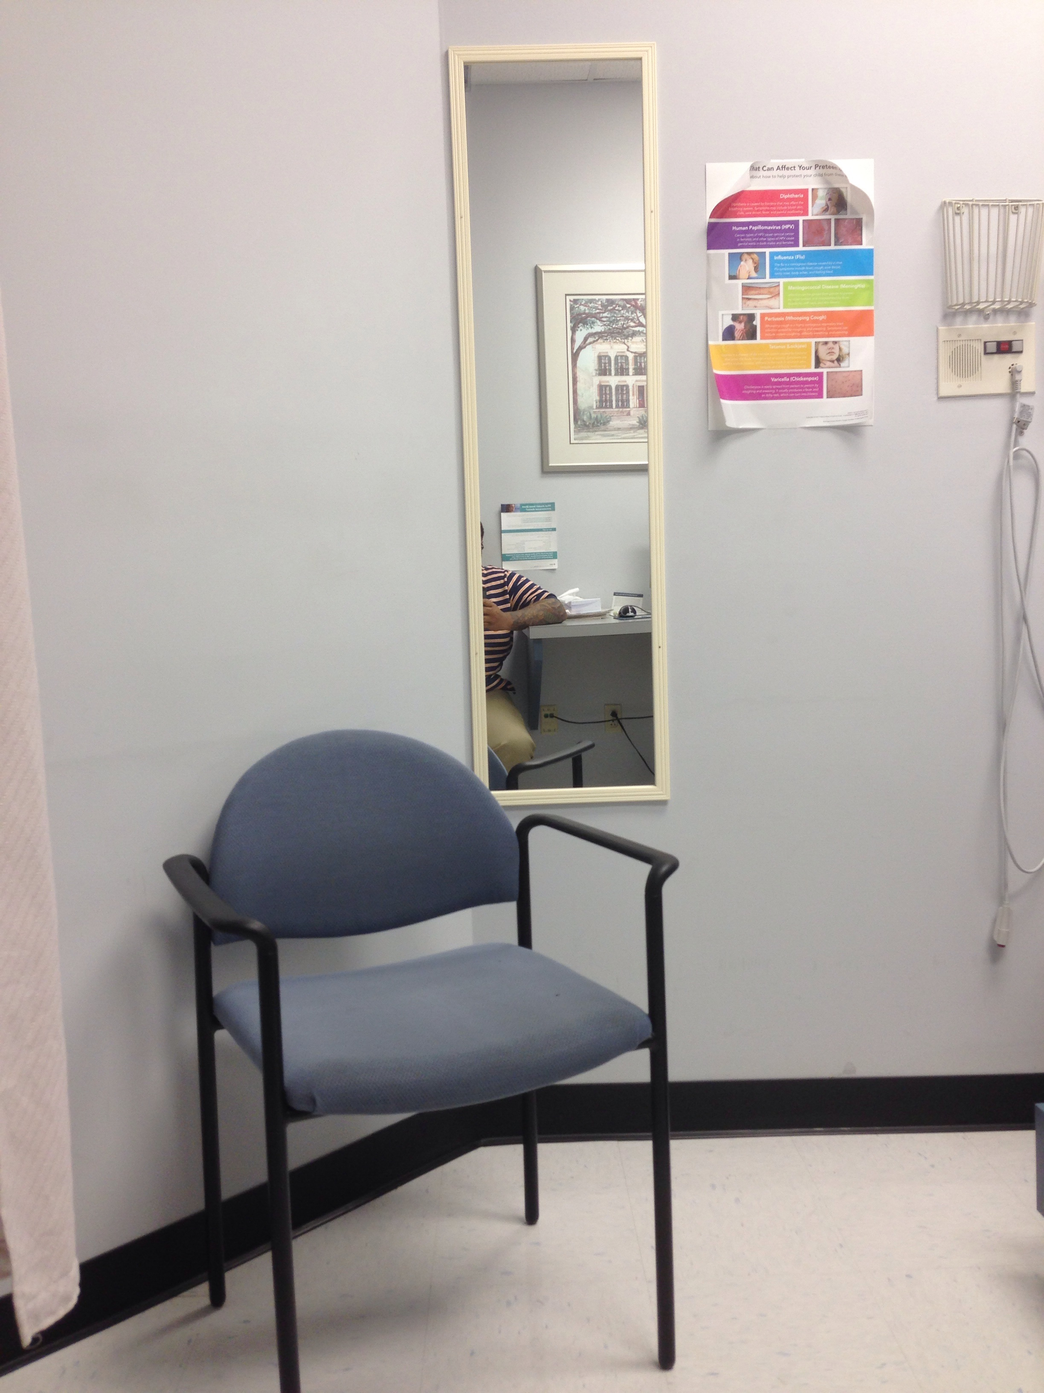
Literature Review
LGBTQ+ interactions with health professionals are consistently negative (Steinke et al., 2016)
Physicians receive minimal training on LGBTQ+ issues (Khalili, Leung, & Diamant, 2015)
LGBTQ+ people can view libraries as irrelevant & untrustworthy (Morris & Roberto, 2016; Adler, 2017)
Health librarianship focuses on universal medical information & education (Morris & Hawkins, 2016; Ma, et al., 2018)
Lack of LIS literature on LGBTQ+ health information practices
Outside literature adopts a behaviors approach
Notes:
Nick
Research demonstrates that interactions with health professionals is consistently negative
These interactions may be due to lack of training, including cultural competency training, among physicians
One study examining medical school curriculum showed that on average professionals receive 15 hours of LGBTQ+ specific training throughout their years in medical school
Like the medical field, libraries can also be viewed negatively by LGBTQ+ people
Some of this negative view can be explained, again, by lack of training
Health librarianship focuses on universal medical information and education at the expense of understanding the unique information worlds of LGBTQ+ and other communities
Lack of LIS research literature on LGBTQ+ health information practices, which can inform health librarianship training
Literature outside of LIS examining the informational aspects of LGBTQ+ health limits examination to needs, seeking, and sources consulted

Slide 6
Research questions
RQ1: How does sociocultural context shape the health information practices of SC LGBTQ+ communities?
RQ2: What are the implications of research findings for LIS education, specifically health librarianship?
Notes:
Nick
Gaps in the literature led informed our research questions (read questions)

Slide 7
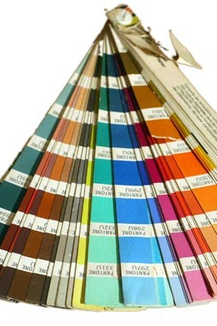
Methods
30 SC LGBTQ+ community leaders ages 13+
IRB waiver of parent/guardian consent
Sampling: Purposive, Snowball, Theoretical
Semi-structured interviews
Information worlds mapping (Greyson, 2013)
In-person interviews (with exception of 2 telephone)
Interviews audio-recorded & transcribed
Open qualitative coding (Strauss & Corbin, 1994)
Validity: Team coding meetings, member-checking, multiple data collection methods
Pseudonyms used
Notes:
Vanessa
Happy to provide more in-depth methods info during discussion
Interviewed 30 SC LGBTQ+ community leaders
Leaders provide a bird’s eye view of their communities
Emailed a list of 100+ LGBTQ+ and affinity organizations in SC asking them to nominate a community leader to participate
Asked leaders to recommend other participants
Used theoretical sampling to inform social media recruitment
Important to note that leaders can be youth; IRB waiver for parent/guardian consent
Semi-structured interviews averaged 78 minutes and covered:
Community involvement identities, health questions/concerns, and practices for addressing questions/concerns
Following interviews, participants engaged info worlds mapping, a visual elicitation method, to provide a diff. way to address interview themes
Data consisted of interview transcripts, field notes, and info world maps
Focus on transcript analysis for this presentation
Met as a group to hand-code three transcripts and build a preliminary codebook
Refined codebook using four additional transcripts
Constantly compared emergent and existing codes, resolving discrepancies among coders
Then coded remaining transcripts independently
Engaged in member-checking where participants accessed their transcripts to comment on how well they reflected lived experiences, as well as highlight any identifying info

Slide 8
Participant Demographics (Age, Race & Ethnicity, Education)
Age | n | %
18-25 | 11 | 37%
35-54 | 7 | 24%
55-64 | 4 | 14%
13-17 | 4 | 14%
26-34 | 3 | 10%
65+ | 1 | 4%
Race & Ethnicity | n | %
White | 18 | 60%
Black | 7 | 24%
Black, White | 2 | 7%
Black, Afro-Caribbean | 1 | 4%
Aboriginal, Arab/West Asian, Black, White | 1 | 4%
Black, White, Egyptian | 1 | 4%
Education | n | %
Some college credit | 7 | 24%
Master’s degree | 6 | 20%
Associate degree | 5 | 17%
Bachelor’s degree | 5 | 17%
In high school | 2 | 7%
In middle school | 2 | 7%
High school diploma | 1 | 4%
Doctoral degree | 1 | 4%
GED or alt. credential | 1 | 4%
Notes:
Vanessa
Majority of participants were young adults (18-25) and middle-aged
Race/ethnicity reflects that of LGBTQ+ people at broader state-level
Under-representation of Latinx communities, which have presence in SC
Education varied, but common for participants to have some degree of higher education

Slide 9
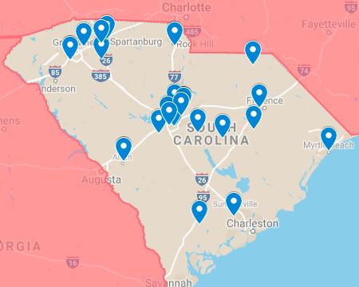
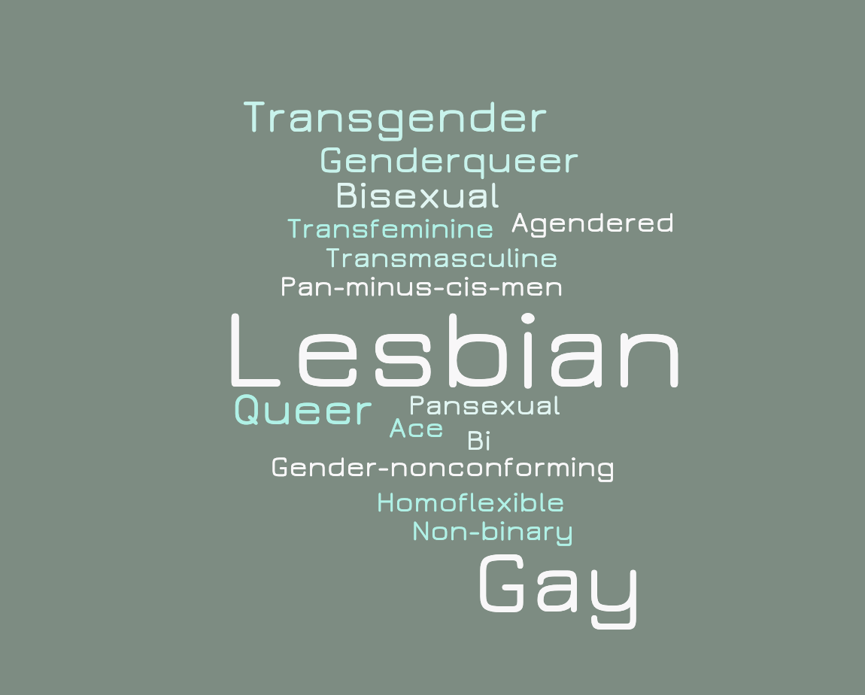
Participant Demographics (Geography, identity)
Notes:
Vanessa
Geographic distribution spread across the state, with concentrations in Upstate and Midlands regions
Fewer participants in Coastal Lowcountry and Pee Dee regions reflect smaller populations and less visible organizations
Charleston has an active, visible LGBTQ+ population, but did not participate in interviews
While most participants identified as lesbian and gay, they used other labels to describe sexualities and gender identities
Denotes inability of umbrella labels like LGBTQ+ to capture multiplicity and fluidity of participant identities

Slide 10
Conceptual model
Risks
Self protective
Community protective
Contextual Conditions
Self defensive
Barriers
Community defensive
Notes:
Vanessa
Through second-cycle coding, we developed a conceptual model describing how sociocultural context shapes the health information practices of LGBTQ+ populations
The first part of the model is contextual conditions
These are underlying circumstances shaping how individuals and communities interact with health information, such as identity, economics, and politics
Contextual conditions produce risks and barriers faced by individuals and communities
Risks are perceived exposure to danger, harm, or loss that might result from engaging in specific information practices
Examples of risks identified during data analysis: physical violence, being kicked out, and fear of the unknown
Barriers are obstacles that constrain individuals and communities from achieving certain informational outcomes
Examples of barriers identified during data analysis: family, law, religion
Risks and barriers are co-constitutive (e.g., what is a barrier for one can be a risk for another when they hear about it)
Risks produce protective information practices
They are instances where individuals or communities create, seek, share, and use information to guard against a perceived risk or risks
These practices are proactive
Barriers produce defensive information practices
They are instances where individuals or communities create, seek, share, and use information to defend against a barrier or barriers
These practices are reactive
Now Travis will illustrate this model with two participant narratives

Slide 11
So if you were to come to me specifically, I’d probably, if you were okay with it, open up to the group, and then if you weren't, if you wanted to be anonymous, then just say, "hey, there's this question that comes in our community a lot. How would you guys answer it?" Just so it's not just me answering something because my experience, obviously, isn't everyone's experience. But we usually open that up to the group, not as a question of the day, but just as a, "hey, does anyone have any advice, questions, concerns regarding the same question or concern or any information that can help?" And then if we don't find it, we usually go online, which I know, again, it's not always the most reliable, but it definitely has helped us when we needed it. But we don't really have that many resources.
Whitney, a White lesbian who leads a college LGBTQ+ group discusses how she and her community address members’ health questions & concerns.
Notes:
Travis
Whitney, a lesbian who leads a college LGBTQ+ group discusses how she and her community address members’ health questions and concerns

Slide 12
Model applied to whitney’s narrative
Risks:
Fear of Unknown
Unwanted Identity Disclosure
Self protective:
Seeking
Community protective:
Seeking
Sharing
Contextual Conditions:
Gender identity
Sexuality
Age
Education
Self defensive
Barriers:
Access
Stigma
Community defensive:
Exchanging
Satisficing
Notes:
Travis
Contextual conditions
Gender identity, sexuality, age, and education are core shared identities of community members
Barriers
Lack of access to health information
Feared stigma by revealing health condition to community
Risks
Potential unwanted identity disclosure if leader chooses to reveal your identity
Potential other, unknown risks in sharing health concerns with other people
Self protective seeking
Looking for information within community first
Community protective seeking
Asking a question on behalf of community member
Community protective sharing
Managing disclosure of seeker’s identity
Community defensive information exchange
Idea that people within community should share to get multiple POVs
Community defensive information use
Satisficing in getting information that’s “good enough” online if it can’t be found in community

Slide 13
One of the things that I know one of the groups in the Upstate has created, and I'm trying to get one created, and updated, and more localized, is just a-- it's not even a pamphlet anymore. It's probably a pretty good sized packet of doctors, ranging again from everybody we talked about. Endocrinologists, electrolysis, therapy, counseling, all of that stuff. Where we have names of doctors that you can go to, and where– [we] even want to expand it to lawyers that will help you with any changes you have, that will help you fight your job if you need to do that. Those kind of things. So having a manual like that is-- I've been working on it since probably about three years ago, but it's just like, doctors change, doctors move. The main group that a lot of people are going to, [NAME], I don't know what happened, but they shut down. So then we had to find the doctors that were working in those places who now have their own practices. So you used to go to such and such [NAME], and there's like five or six doctors in there. They all split, and they all shut down, and that was a pretty hard hit in the community health-wise. Because people were panicking, like, "What am I going to do? Where am I going to go?”
Tony, a Black trans male community activist describes information he wishes his community has, but doesn’t.
Notes:
Travis
Tony, a trans male community activist describes information he wishes his community has, but doesn’t

Slide 14
Model applied to Tony’s narrative
Risks:
Fear of Unknown
Self protective
Community protective:
Creating
Contextual Conditions:
Race
Gender identity
Sexuality
Geography
Law
Self defensive:
Seeking
Barriers:
Access
Homophobia
Transphobia
Environmental
Community defensive:
Seeking
Notes:
Travis
Contextual conditions
Gender identity and sexuality shape what doctors are relevant for you to see
Law shapes what types of discrimination you may or may not be exposed to you
Geography determines what’s accessible to you in your immediate environment
Barriers
Lack of access to health professionals
Homophobia and transphobia limiting the amount of medical professionals available to see you
Environmental barriers like lack of persistence make it so that “doctors change, doctors move”
Risks
Potential other, unknown risks in visiting non-vetted doctors
Community protective creating
Creating a list of vetted doctors to protect against a situation like the one Tony recalls happening again; this time people will know where to go
Self defensive seeking
Community members need to know where to go that’s safe/vetted
Community defensive information seeking
After the event Tony describes happened, he worked to find out where doctors from the practice went – did they open up private practices that people could now visit?

Slide 15
Implications for LIS Global Education
Need for social responsibility & diversity in LIS education
Importance of community engagement instead of outreach
Practical, rather than theoretical, approach to outreach
New teaching methods:
Set of skills to determine how sociocultural context shapes information practices
Shift from passive learning to active learning
Notes:
Val
As librarians, we need to deliver high-quality information to all members of society
Findings from this study further indicate that LIS education would benefit from embedding more social responsibility and diversity into curricula, as they emphasized importance of mediation between community and information.
Community is viable context to assess information practices – LIS education would benefit from bringing diverse range of communities into curricula – encourage more community-based research
Outreach discussed theoretically – more practical approach
Conducting outreach in the community would allow students to engage in marginalized information research and understand the social and structural barriers that contribute to information poverty
Emphasizing these concepts of social responsibility and diversity would help develop more socially conscious librarians who act as agents of change
New content and teaching methods
Develop set of skills to assess factors that affect information needs
Passive to active learning – social responsibility education is actively learning by doing
When we teach about services, this is where our research information belongs

Slide 16
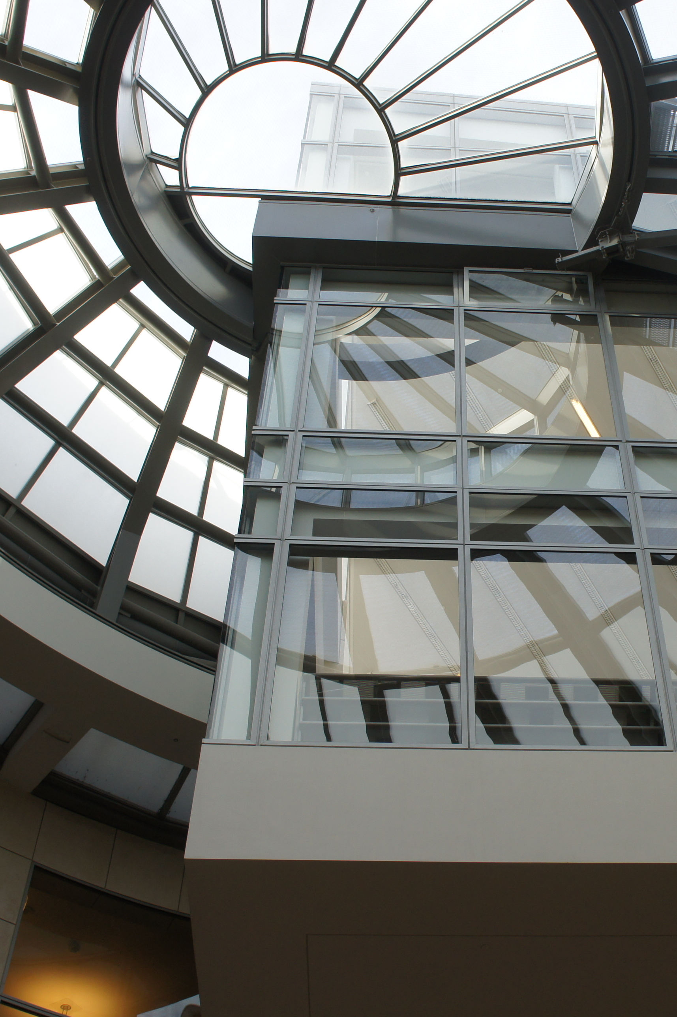
Implications for Health Librarianship
Health librarians serve as information intermediaries between patients & health practitioners
  Inform medical professionals of sociocultural barriers & risks experienced by communities
Practical learning experiences based in the community
  Nuanced understandings of their communities before working with them professionally
Notes:
Val
Findings from this study have suggested that distributing health resources have a ripple effect and can aid countless community members in unseen and unknown ways
Health librarians, consumer health librarians, serve as intermediaries between patients and health practitioners
They cannot only locate a variety of information resources but deliver them in a user-oriented way
They have the unique opportunity to inform medical professionals of the sociocultural barriers and risks that impact an individual’s access to information, as well as share the information collectively sought and disseminated by communities
LIS education should incorporate practical learning experiences to students pursuing health librarianship
Health librarians require nuanced understandings of the sociopolitical and cultural climates within their communities, thus students pursuing these careers would benefit by being embedded into these communities before working with them in a professional sense.

Slide 17
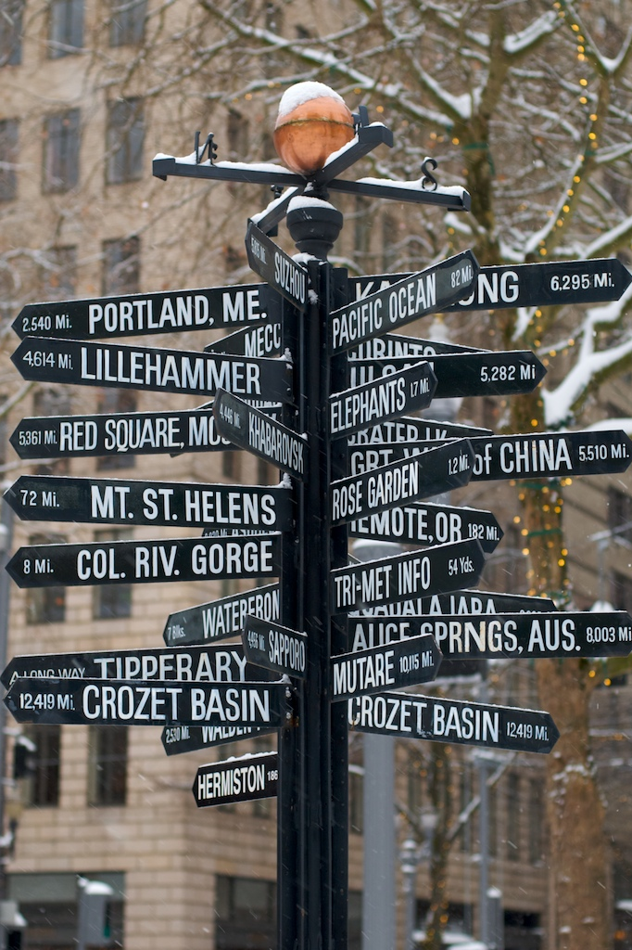
Future Directions
Focus groups with SC LGBTQ+ leaders’ community members
Recruit underrepresented participants in current sample
Interviews with health & medical librarians, medical practitioners
Notes:
Val
This research has several future directions. Our next step is to conduct focus groups with participants’ communities to validate and expand the current findings from our leader interviews. We’ll also work on employing more nuanced and embedded strategies to recruit participants who are underrepresented in the current sample. In the future, we’ll also conduct interviews with health and medical librarians, in addition to medical professionals, to better understand their information practices in relation to the LGBTQ+ communities they serve.

Slide 18
Thank you!
Questions?
For more project info:
http://bit.ly/hiplgbtq
Notes:
Val

Slide 19
References (1)
Adler, M. (2017). Cruising the library: Perversities in the organization of knowledge. New York, NY: Fordham University Press
Cooke, N. A. (2018). Creating Mirrors and Doors in the Curriculum: Diversifying and Re-Envisioning the MLS. In Re-envisioning the MLS: Perspectives on the Future of Library and Information Science Education (pp. 27-48). Emerald Publishing Limited.
Greyson, D. (2013). Information world mapping: A participatory, visual, elicitation activity for information practice interviews. Proceedings of the American Society for Information Science and Technology, 50(1), 1-4.
Hillary G. A. (1995). Definitions of community: Areas of agreement. Rural Sociology, 20, 111-123.

Slide 20
References (2)
Hoffman, N. D., Freeman, K., & Swann, S. (2009). Healthcare Preferences of Lesbian, Gay, Bisexual, Transgender and Questioning Youth. Journal of Adolescent Health, 45(3), 222–229.
Irvin, V. (2016). Gazing the diversity stance in North America: Bringing practitioner inquiry into the LIS classroom. Journal of Education for Library and Information Science, 57(2), 151-160.
Jaeger, P. T., Bertot, J. C., & Franklin, R. E. (2010). Diversity, inclusion, and underrepresented populations in LIS research. The Library Quarterly, 80(2), 175-181.
Klein, E. W., & Nakhai, M. (2016). Caring for LGBTQ patients: Methods for improving physician cultural competence. The International Journal of Psychiatry in Medicine, 51(4), 315-324.

Slide 21
References (3)
Lockmiller, C. (2019) Against medicine: Constructing a queer-feminist community health informatics and librarianship. In the Library With The Leadpipe. Retrieved from http://www.inthelibrarywiththeleadpipe.org/2019/against-medicine/
Ma, J., Stahl, L., & Knotts, E. (2018). Emerging roles of health information professionals for library and information science curriculum development: a scoping review. Journal of the Medical Library Association: JMLA, 106(4), 432.
Martin, E. R. (2019). Social justice and the medical librarian. Journal of the Medical Library Association: JMLA, 107(3), 291.

Slide 22
References (4)
Morris, M., & Hawkins, B. (2016). Towards a new specialization in health librarianship: LGBTQ health. Journal of the Canadian Health Libraries Association, 37(1), 20-23. Pohjanen, A. M., & Kortelainen, T. A. M. (2016). Transgender information behaviour. Journal of Documentation, 72(1), 172-190.
Savolainen, R. (2008). Everyday information practices: a social phenomenological perspective. Scarecrow Press.
Steinke, J., Root-Bowman, M., Estabrook, S., Levine, D. S., & Kantor, L. M. (2017). Meeting the needs of sexual and gender minority youth: formative research on potential digital health interventions. Journal of Adolescent Health, 60(5), 541-548.

