Slide 1
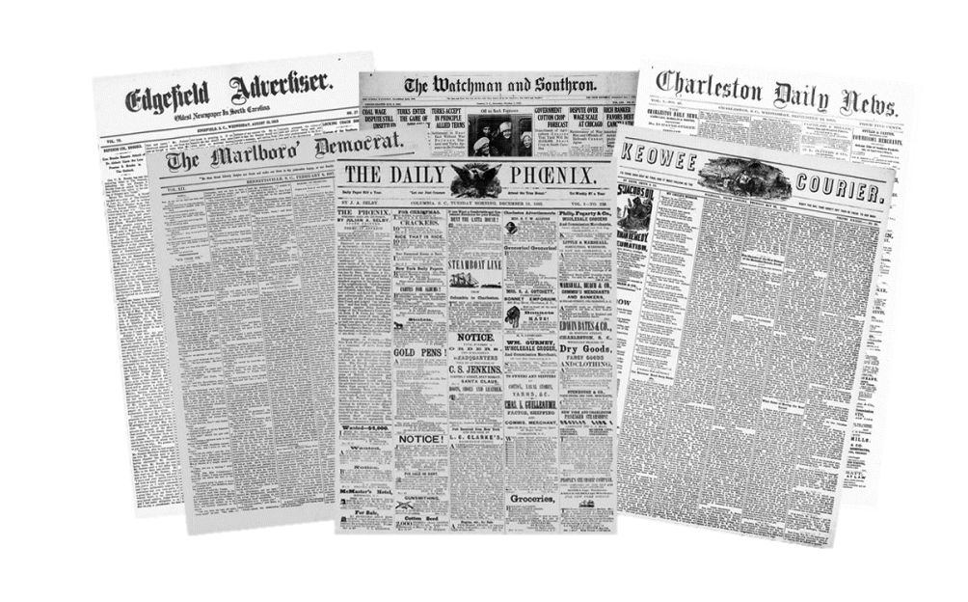
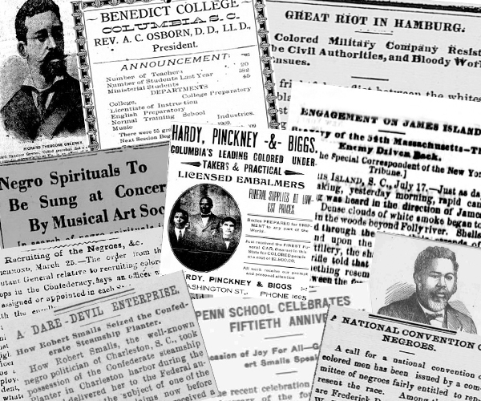
Introducing the Historical Newspapers of South Carolina Online Database
May 11, 2018
Kate Boyd
Digital Initiatives Librarian
University of South Carolina Libraries
http://historicnewspapers.sc.edu/
Notes:
How many of you have heard of the Chronicling America project? Seen a presentation on that?
So excited to share with you today the technical side of our new resource for historic SC newspapers, freely available online
but before we get to that, let me catch you up on how we got here. Give you some background and a few technical details on how we got here.

Slide 2
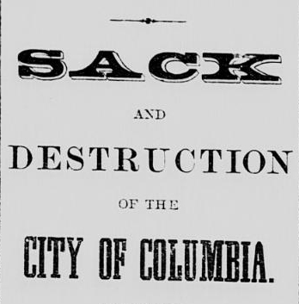
Why Digitize Newspapers
Rich history, historical record
Primary resource
Notes:
How many of you have heard of the Chronicling America project? Seen a presentation on that?
So excited to share with you today the technical side of our new resource for historic SC newspapers, freely available online
but before we get to that, let me catch you up on how we got here. Give you some background and a few technical details on how we got here.

Slide 3
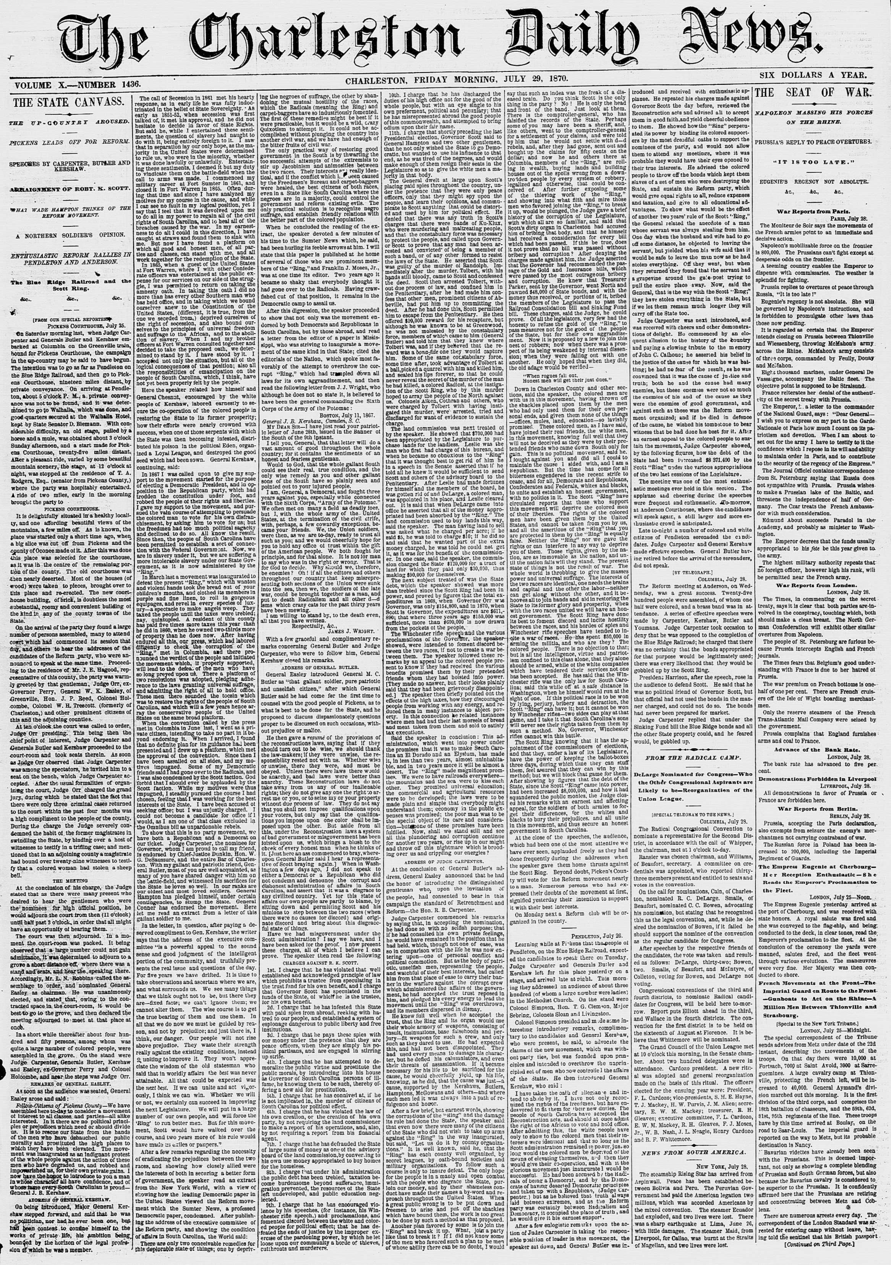
Much easier to search and view online

Slide 4
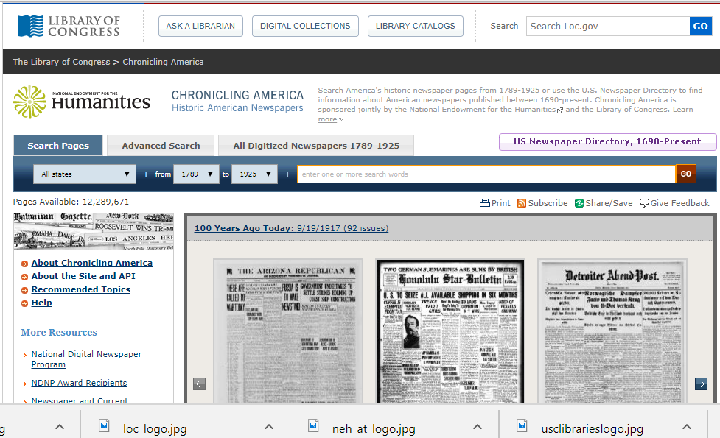
2009-2015
Notes:
How this all started -
The team here – wrote 4 grant applications to NEH and received funding 3 times, just shy of a million dollars in funding
Scanned newspapers form 2009-2015 with NEH funding and working with LC’s Chronicling America site

Slide 5
Microfilm Inspection
Notes:
Used a vendor for all of this work to scan from microfilm and create batch metadata
Used Excel to create page level metadata in house, looking at each page
Example of workflow during this time and the results at LC, note full text searchability

Slide 6
Metadata Creation
Notes:
Quality review of metadata

Slide 7
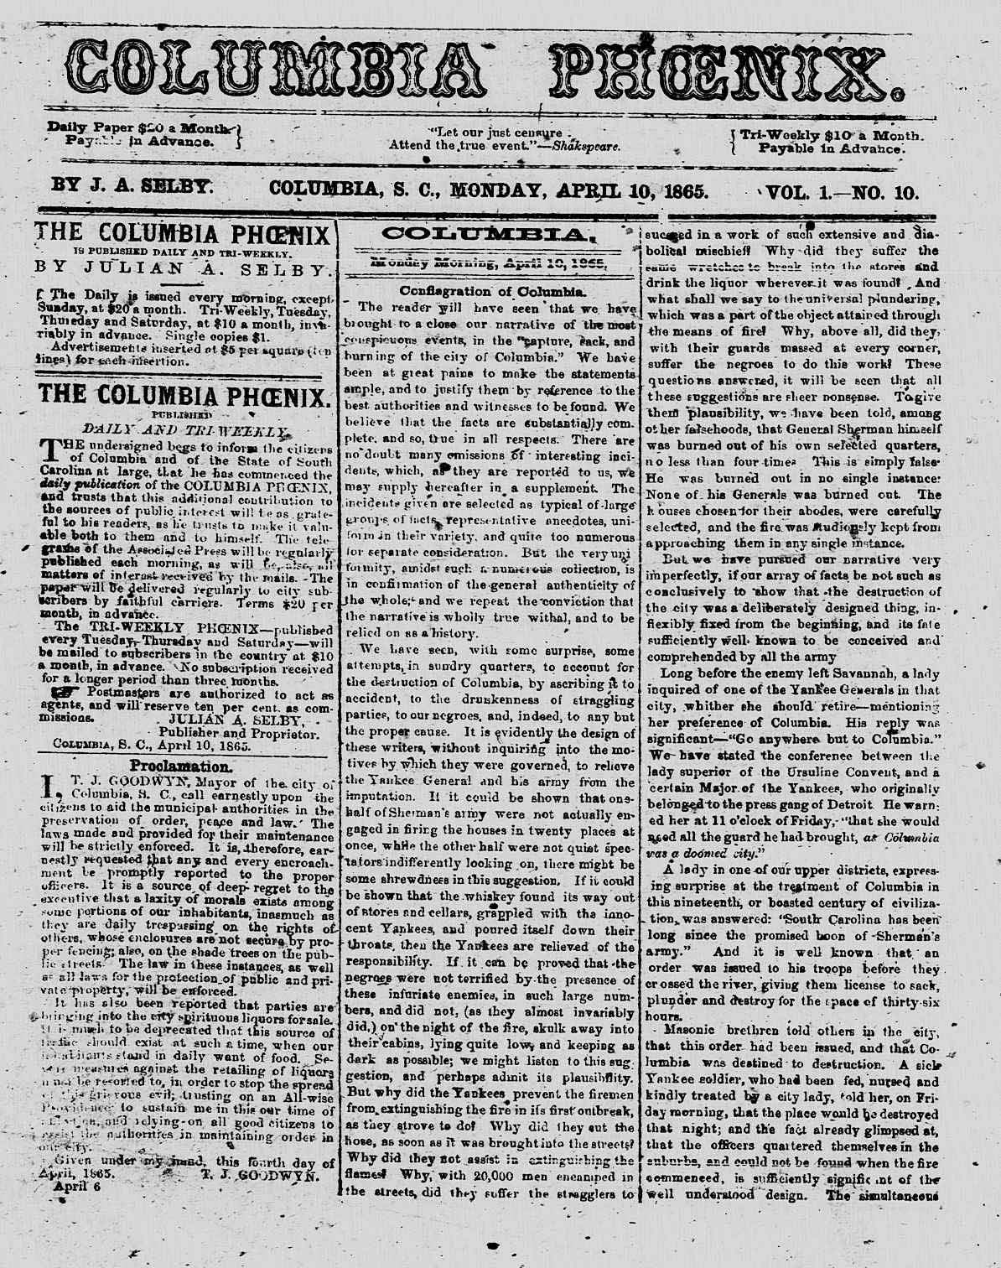
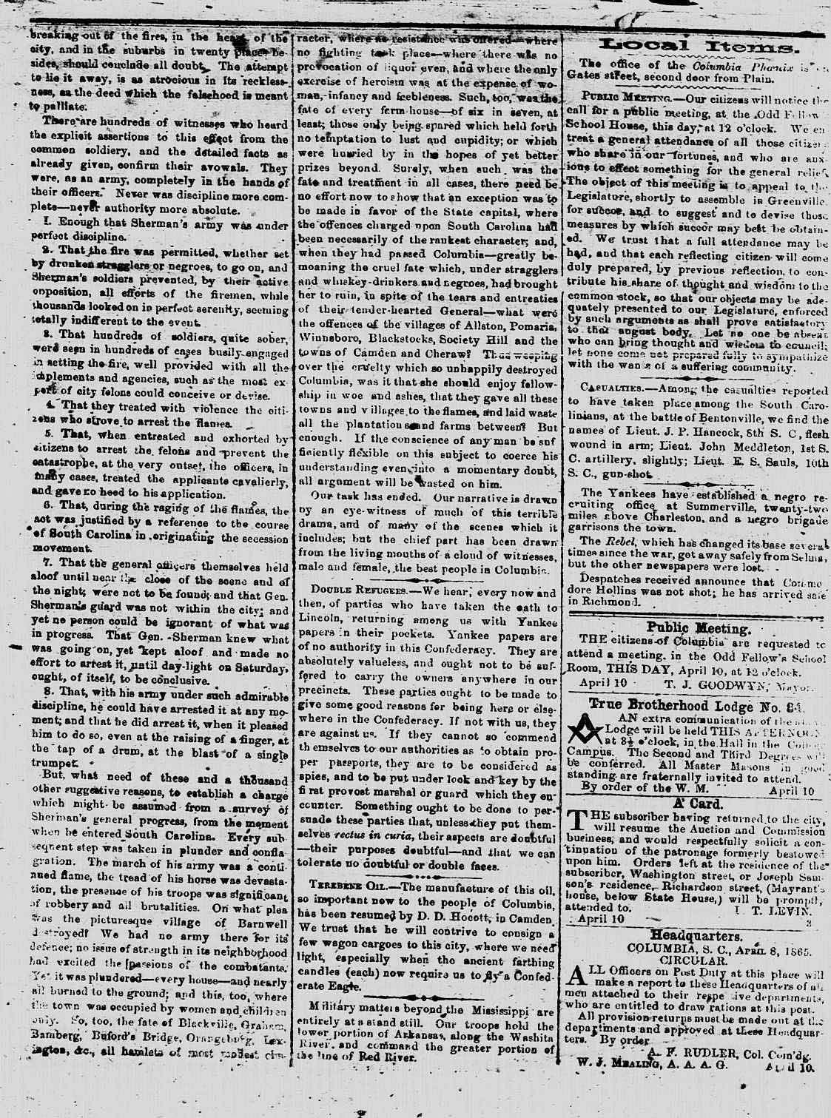
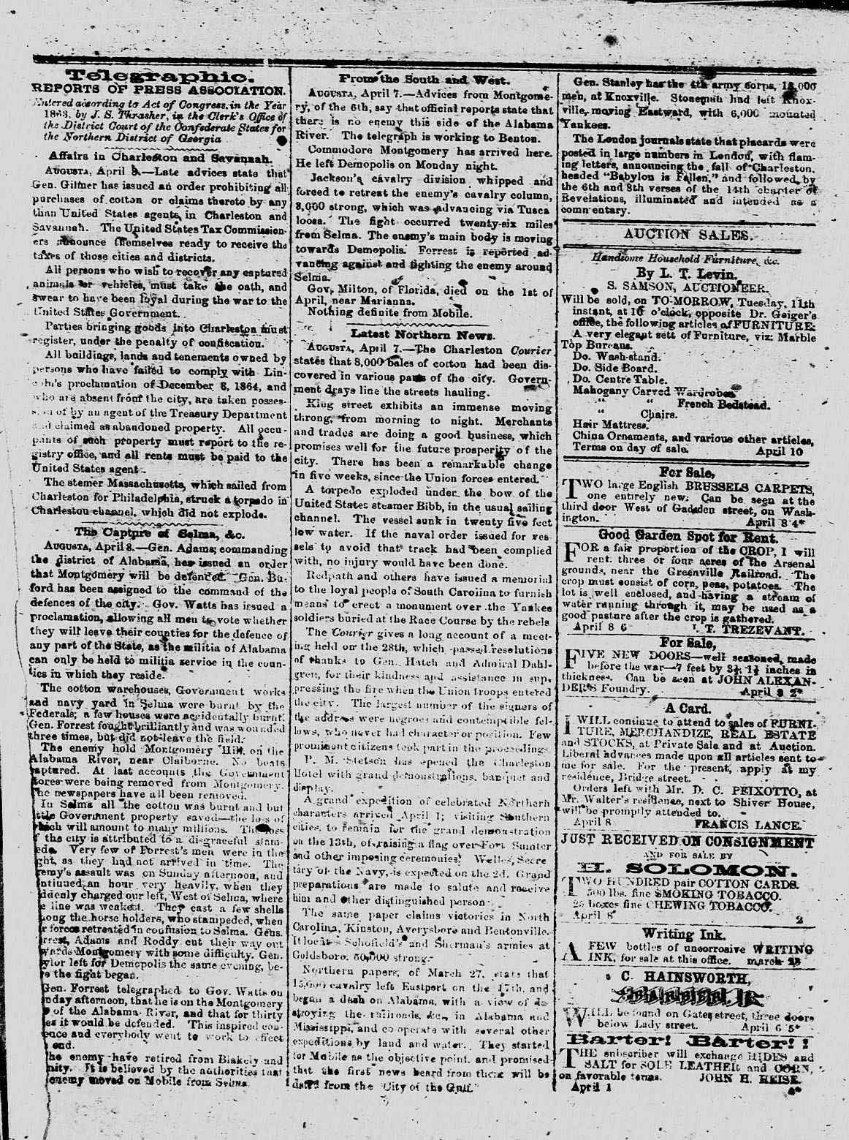
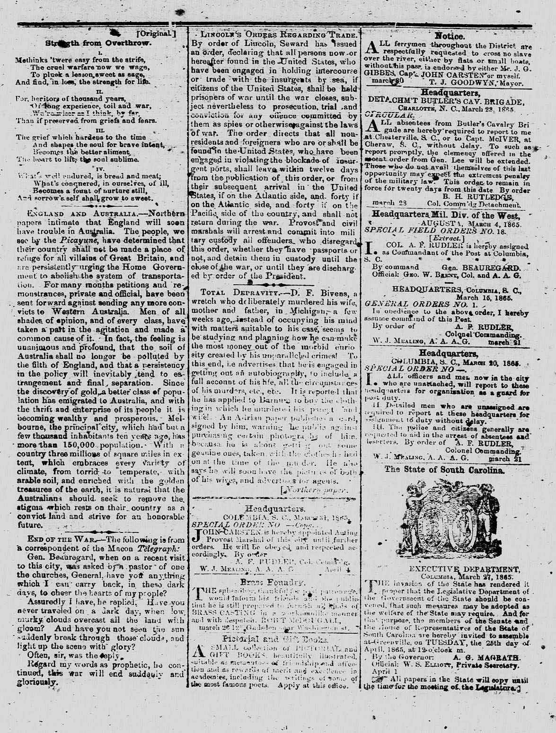
Digital Version
Page 1
Page 2
Page 3
Page 4
Notes:
Digitization by 3rd party vendor (Apex)
Quality review of digital data

Slide 8
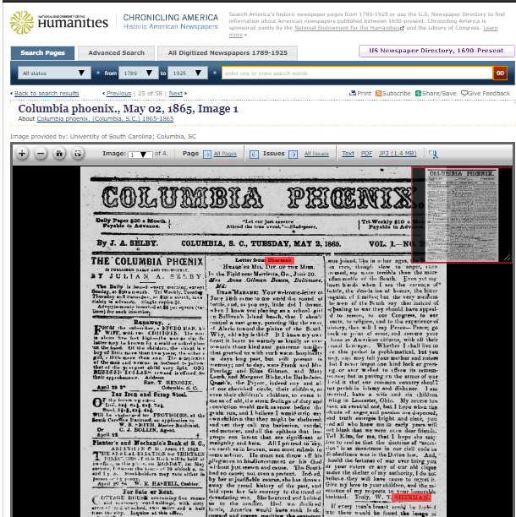
From Microfilm to Digital
Notes:
Our program builds on an earlier national project in the 1980s and 1990s in which original newspapers were microfilmed; almost 1 million newspaper pages at the South Caroliniana were microfilmed from that project.
Results:
1,249 titles
990,332 pages
$397,893 in NEH support
Union List of S.C. newspapers
1. When creating digital versions, we are able to create order out of chaos at times. Some of the microfilm we inspect is out of order, backwards, askew, missing pages, etc. In the digitization process, we are able to correct and improve your experience when you use the newspapers online. We are able to put pages in order, putting issues in order chronologically, removing poor images, etc. Generally clean the papers up and make them easier to browse online.
2. So, we digitize each newspaper page and the digital version will look like these: in correct page sequence order, in correct chronological order, cropped apart if necessary, organized and clean versions. When they are digitized, much easier to research, browse, and keyword search. 400 dpi (if someone asks).
3. Finally, this is what the newspapers look like in Chronicling America. We will provide more details about the site later on as we give a live demonstration of how to use it.

Slide 9
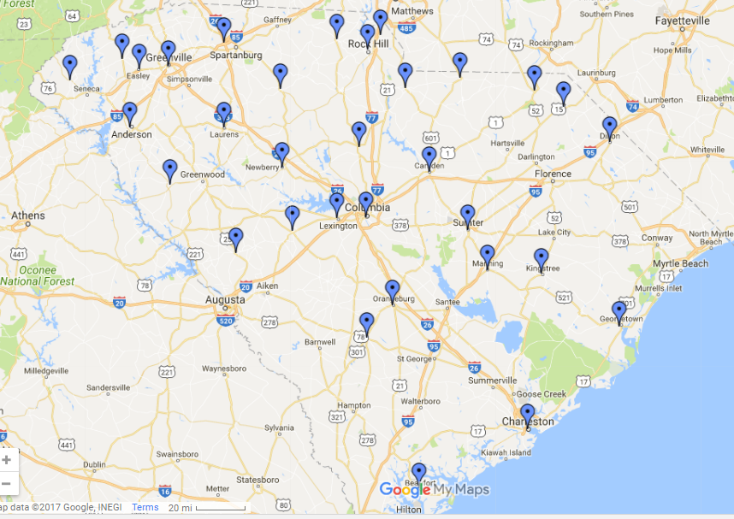
SC Titles in LC’s Chronicling America
Scanned 304,786 pages
110 S.C. newspaper titles scanned from all over the state
African American titles and papers of record in small and large cities
Dates, 1836-1923 (87 years)
Formatting an issue earlier than 1836
copyright issues after 1923
588 rolls of microfilm scanned and sent to Library of Congress for preservation

Slide 10
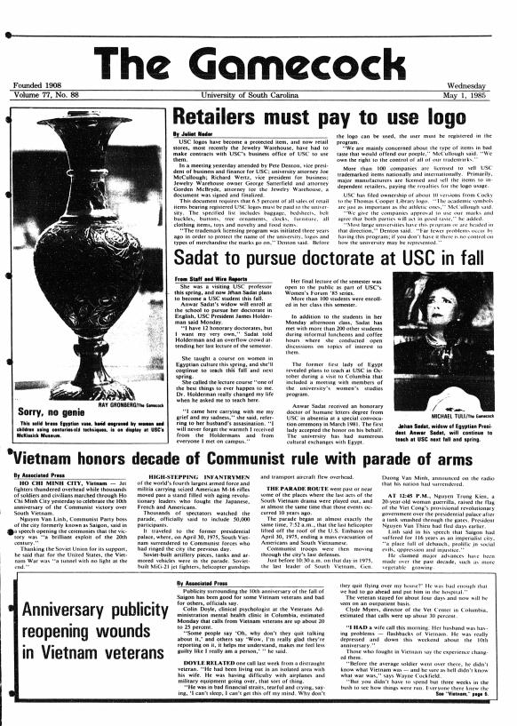
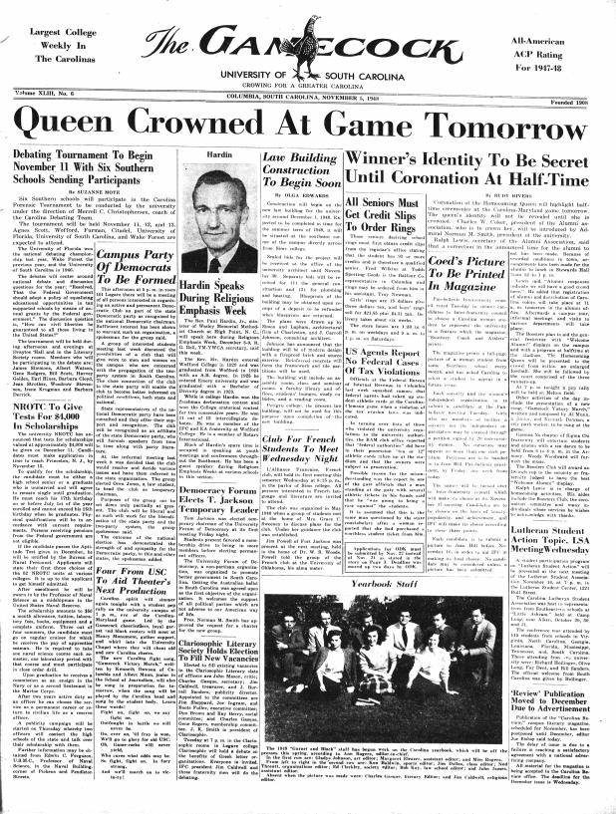
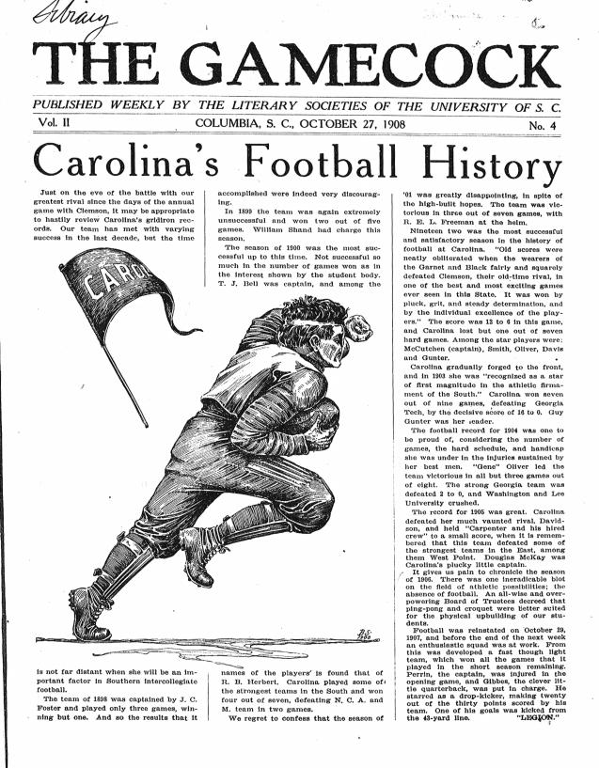
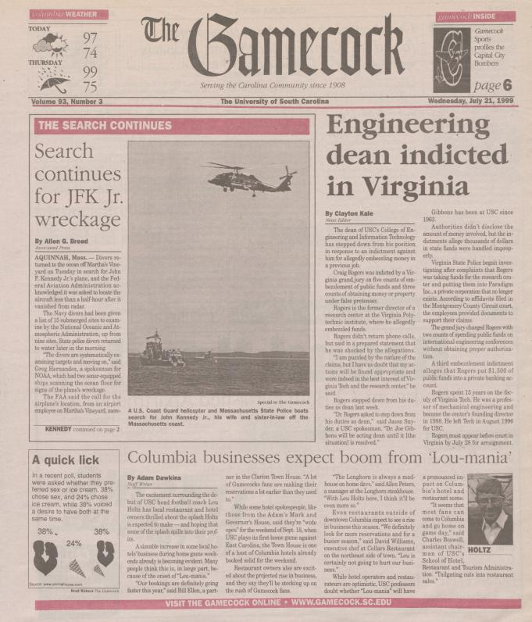
Student Media donates funding to purchase server and outsource scanning
Scan and make available online 1908-2006, entire archive now available online and full text searchable
http://www.sc-newspapers.sc.edu/
http://library.sc.edu/p/Collections/Digital
Notes:
2010 - ChronAm software for Gamecock – money from Student Media to scan and load
Followed LC guidelines and continued to use vendor
1908 -206 here

Slide 11
2013-2016, Post NEH Beginnings
Funding from local institutions began
2013, Crowley Company donates a Mekel Mach 12 scanner
Re-install ChronAm again on another server
Purchase ABBYY Recognition Server software
UNC develops scripts to work with ChronAm software
Downloaded from Github
Begin learning scripts and in-house process, so we no longer need a vendor
Notes:
Now things start getting complicated. We see the end of the NEH funding and are trying to figure out how to keep this going
2013 Crowley Company donated a Mekel Mach 12 microfilm scanner to us.

Slide 12
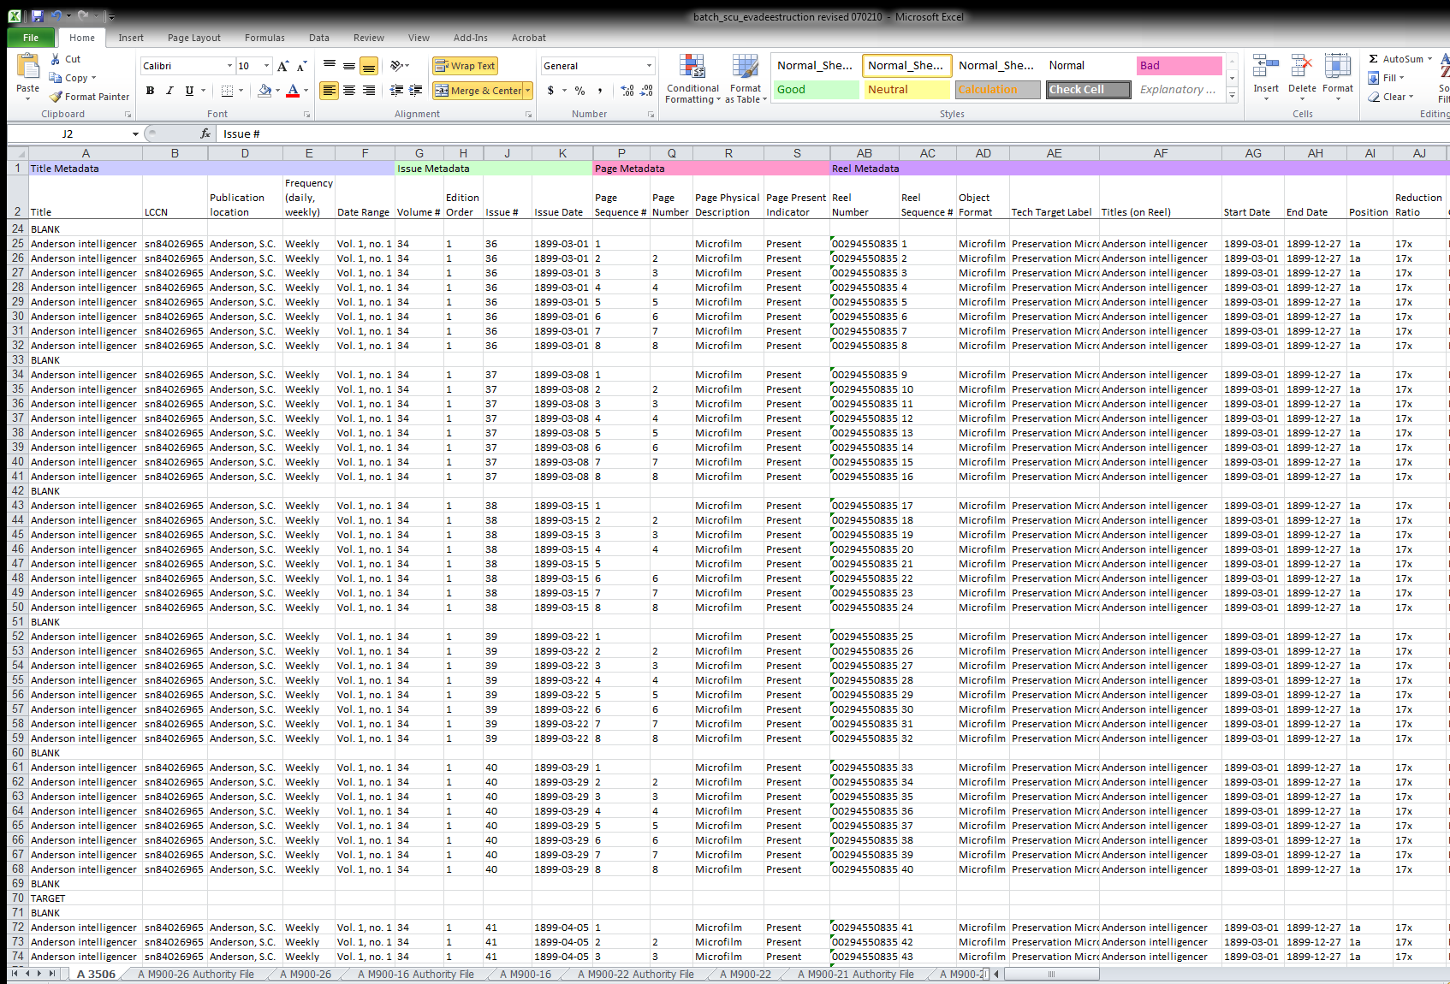
In-House Process
Scan film on Mekel to jpeg
Create metadata for newspapers in Excel
Create derivative files (JP2, PDF, and XML ALTO) with ABBYY Recognition server
Crop images and organize to match metadata
Create XML from Excel and run UNC scripts to create METS XML files and organize images into folders
Load batch data to server

Slide 13
Dig a little Deeper
Scan film and create Excel metadata
Use a lot of concatenations in excel
ABBYY and scripts
Rename script
Excel to XML
Reformat Alto markup
Process file bat
Bibliographic record from catalog to ChronAm
Load and index

Slide 14
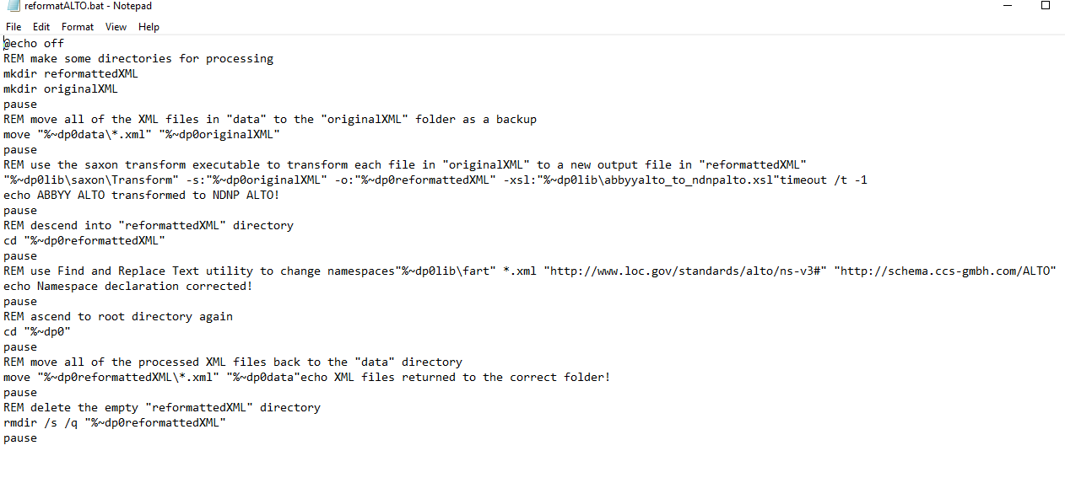

Slide 15
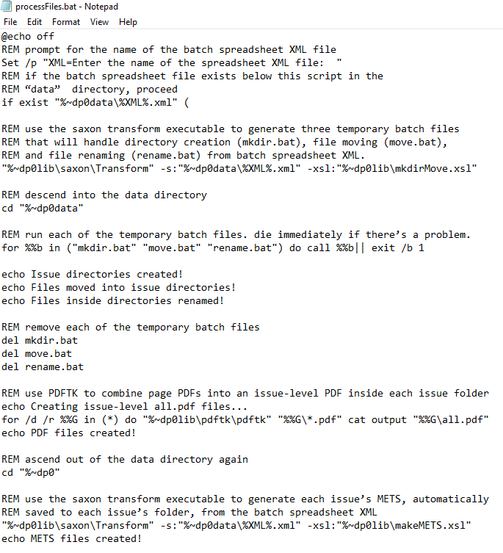

Slide 16
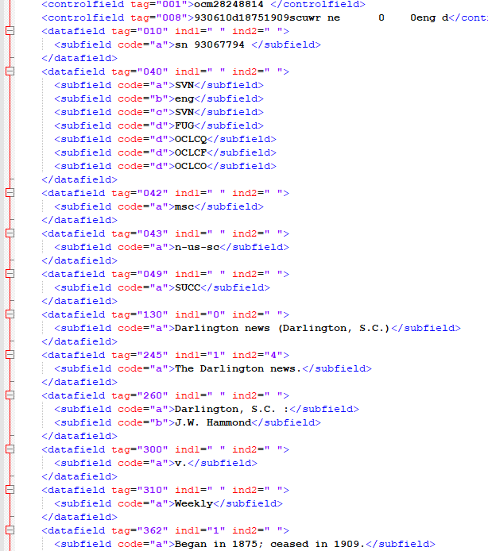

Slide 17
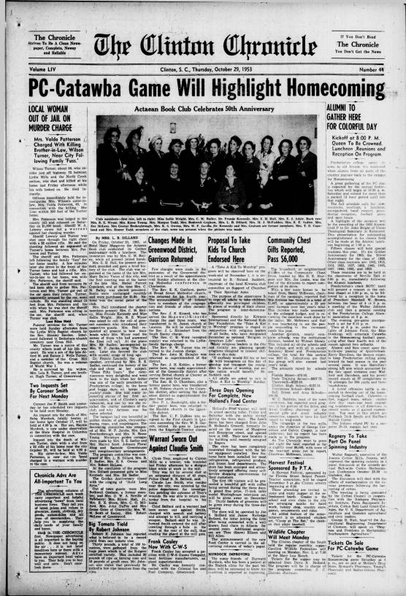
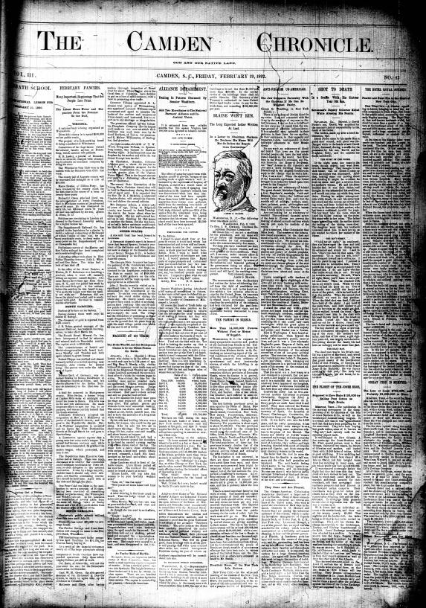
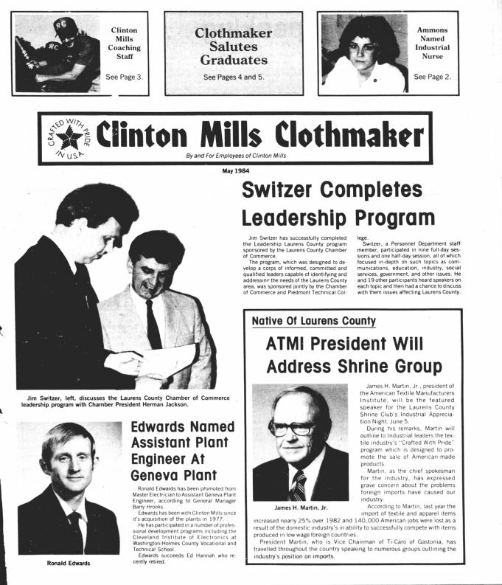
2016-2017
Horry County Archive Center funded Horry papers
LSTA funding and Presbyterian College funding
Scanned Camden Chronicle (1891-1948) and Clinton Chronicle (1925-1960)
Started In-house process with Clinton Chronicle
Launched this September with all NEH titles, plus –
African American Civil Rights papers
Clinton Mills Clothmaker, 1984, mill paper
Barnwell People is next

Slide 18
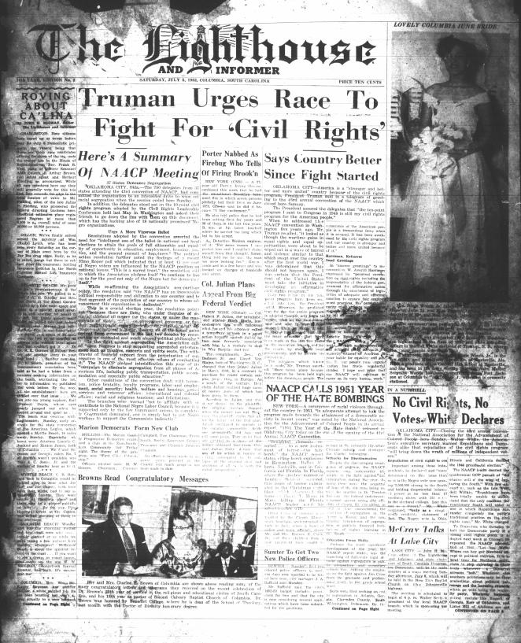

Slide 19
Site Tour
Historic Newspapers of South Carolina

Slide 20
Tomorrow
Working to make sure there is a paper from every county in the state
Need titles for: Aiken, Allendale, Berkeley, Calhoun, Cherokee, Darlington, Dorchester, Florence, Greenwood, Hampton, Jasper, Lee, Marion, McCormick, and Saluda
Overlay this with our other digital collections, so both can be searched at once
Start scanning original papers that aren’t on microfilm, when necessary and adding those

Slide 21
Pros and Cons in-house vs vendor work
Vendor
In-House
Pros
Send out microfilm and metadata and comes back ready for ingest
Can process larger batches
Less mistakes and vendor understands ChronAm process well
Cons
Funding harder to find for a vendor then part time staff funding
Vendor takes longer, but can process more
Pros
No sending out and waiting for files to return
Takes less time, if all goes well
Can process smaller batches and not have to find large amounts to get done and send at once, can manage production a little better
Easier to use my staff funding than ask for outside vendor funding each time
Cons
Smaller batches
When we make mistakes, have to figure it out and fix it ourselves, which can be time consuming

