Slide 1
Data Management Plans & The DMPTool
Pixabay Image. https://pixabay.com/illustrations/cyber-network-technology-futuristic-3400789/

Slide 2
Image CC BY-NC from University of Southern California Santa Cruz (http://guides.library.ucsc.edu/datamanagement/).
Notes:
Data Management Plans are documents that lay out what will happen to research data during and after the project. They’re required as part of the application process by many federal funders, such as the NSF, NEH, and others. They are also required to publish in some journals. Researchers often think of DMPs as just a necessary step in the application process that must be completed so they can get funded, but a good plan is more than that.
A good Data Management Plan helps researchers ensure that their data is findable, accessible, and reusable by themselves and by others in their research community.

Slide 3
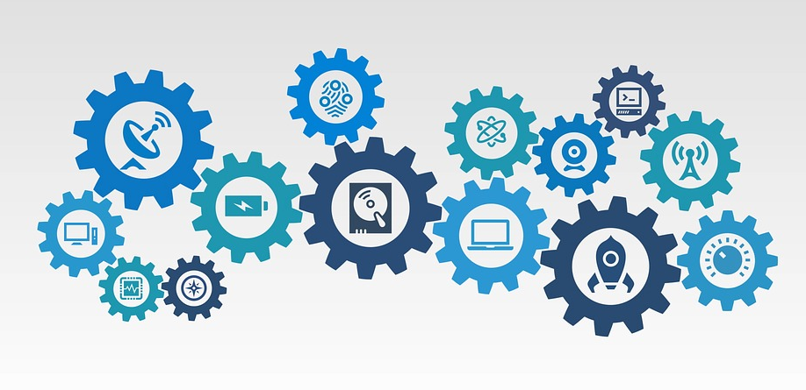
Why plan for data management?
Save time and effort down the road
Enhance the value and usefulness of your data long-term
Makes it easier to share data, which increases research impact
Funder requirements
Pixabay Image – https://pixabay.com/illustrations/technology-information-digital-2082642/
Notes:
You may be required by your funder to share your research data. By thinking about how you’ll collect it ahead of time, you can make it easier for others (and yourself) to reuse your data in the future.
Select a data repository and understand their requirements
Select a metadata schema – many disciplines have established schemas to help other members of the research community find, access, and use it
Make sure you understand how your data will be stored and backed up to ensure that there is no data loss. Make sure that you understand how your research group will handle version control
Plan for access rights and usage agreement or restriction

Slide 4
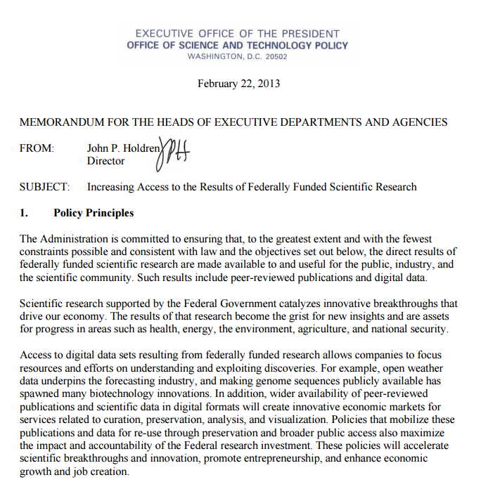
Notes:
In 2013, the Obama administration released a memorandum requiring data and articles resulting from federally funded research be made public. This funding mandate now comes from many federal and private funders and from some publishers.
Funders requiring some level of data sharing.
NSF
NIH
Gordon and Betty Moore Foundation
Institute of Museum and Library Services
NEH
National Oceanic and Atmospheric Administration
Bill and Melinda Gates Foundation
National Institute of Justice
Institute of Education Sciences
Requirements vary by funder.
So, what’s in a DMP? 1-2 page document that lays out what will happen to datasets during and after the research project.

Slide 5
When should you plan for data management?
At the very beginning! Before you collect data.

Slide 6
Today
UofSC Resources for Data Management
What goes in a data management plan
DMPTool

Slide 7
Research Data Management
So, what do we mean by data management?
Preserve data integrity and authenticity
Organize the data
Describing the data with metadata and recording it history (provenance)
Facilitating appropriate access or restricting access as appropriate
Transferring custody to a data repository when it’s time
And more…

Slide 8
Data Management Plans
Requirements vary by funder, but might include:
Description of data to be collected or generated
Storage and backup description
Metadata standard
Access and sharing description
Archiving selection and retention period
Ethics and privacy
Quality assurance
Notes:
There are various checklists for data management plans. Here’s one from the UK’s Digital Curation Centre
http://www.dcc.ac.uk/sites/default/files/documents/resource/DMP/DMP_Checklist_2013.pdf

Slide 9
Check Yourself!
Read through the checklist:
How many of these questions can you answer?
Would you know where to find the answers?

Slide 10
Resources to help you get started
Online Guide to Data Management http://guides.library.sc.edu/rdm
Online Collection of Data Management Plans by USC Researchers https://login.pallas2.tcl.sc.edu/login?url=http://guides.library.sc.edu/uscdmp

Slide 11
guides.library.sc.edu/RDM
Notes:
http://guides.library.sc.edu/rdm

Slide 12
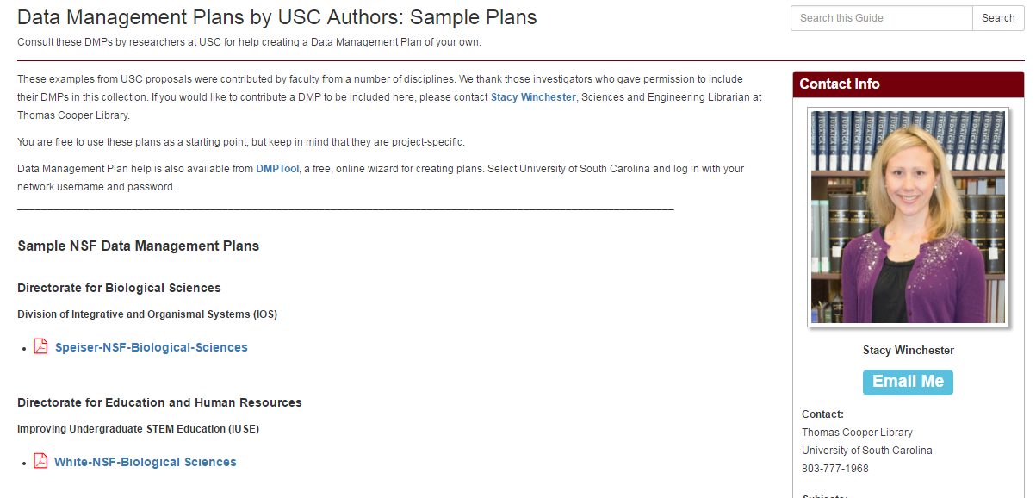
https://login.pallas2.tcl.sc.edu/login?url=http://guides.library.sc.edu/uscdmp

Slide 13
Notes:
https://dmptool.org/
Log into DMPTool by clicking Sign In, then select Option 1: If Your Institution is affiliated with DMPTool. Type University of South Carolina, then sign in with your network username and password.
If you have colleagues at other institutions or agencies that are not affiliated with DMPTool, they can still use it. They can select Option 2.
Let’s go through creating a plan together.

Slide 14
Stacy Winchester
Research Data Librarian
winches2@mailbox.sc.edu
803-777-1968

