Slide 1

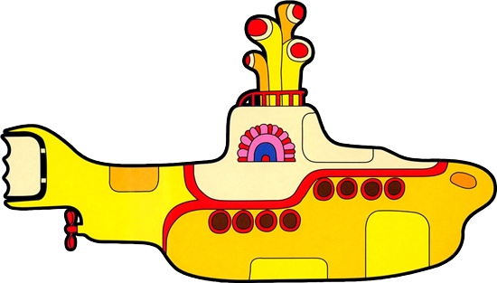
Collaboration in CONTENTdm Projects
Jessica Short . Ashley Knox . John Quirk

Slide 2
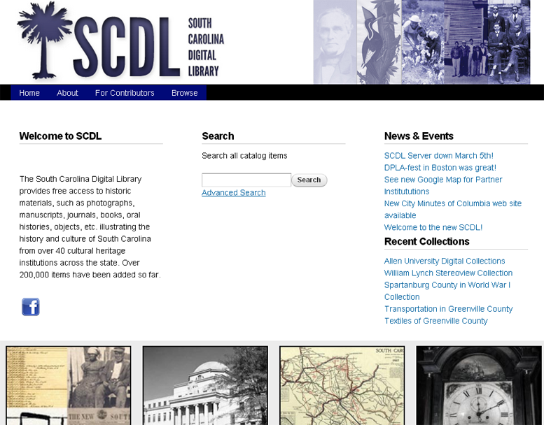
scmemory.org
Notes:
Thanks Ashley…
-The project discuss today: The South Carolina Digital Library (SCDL)
-I’m sure some of you are aware of it…possibly even some involved in it…
-SCDL offers interesting opportunity to explore the Rewards & Challenges of collaborating with a wide variety of people

Slide 3
Technical Details
Statewide Harvester
Over 40 Institutions
Over 100,000 Items
Drupal Platform
Blacklight - Coming soon!
Notes:
-Statewide harvester aggregates the holdings of over 40 institutions and over 100,000 items from across the state of south Carolina
This year upgraded to a Drupal interface – sleeker – easier to use
Currently pkp harvester – soon moving to Blacklight – interesting facetted search functions

Slide 4
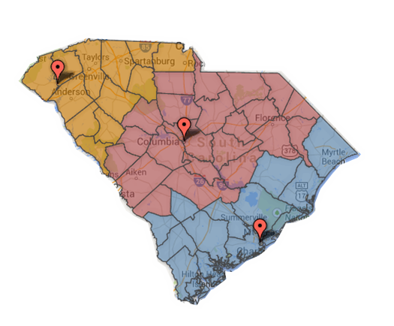
Three Regional Scanning Centers
-Technical Issues
-Metadata Guidelines
-Grants Administration
-Outreach
Layers of Collaboration
Notes:
-SCDL is made up of 3 scanning regions : upstate, along the coast and here in the midlands
-Because of this structure the SCDL is a collaborative effort on a number of levels
-while today I want to concentrate on the level of collaboration that takes place directly with participants…it is worth noting the other levels…
On the statewide/institutional level – collaboration occurs on:
-Technical issues, Metadata Guidelines, Grants administration and Outreach efforts

Slide 5
Three Regional Scanning Centers
-Technical Issues
-Metadata Guidelines
-Grants Administration
-Outreach
Within Regions:
-Equipment Scheduling
-Staffing
-Project Prioritization
Layers of Collaboration
Notes:
Within the scanning regions – collaboration on:
Equipment scheduling, Staffing and project prioritization

Slide 6

Three Regional Scanning Centers
-Technical Issues
-Metadata Guidelines
-Grants Administration
-Outreach
Within Regions:
-Equipment Scheduling
-Staffing
-Project Prioritization
Communication…
SCDL wiki!
Layers of Collaboration
Notes:
I should also mention that the SCDL was selected as a DPLA content hub…
This adds another, sort of tangential collaborative relationship that effects our metadata standards
As with all collaborative efforts…communication is key- SCDL Wiki!

Slide 7
Encouraging New Digital Initiatives
Academic Institutions
Museums
Historical Societies
Libraries
Municipalities
Notes:
-The SCDL Mission – to encourage new digital initiatives
This results in collaborating with a wide variety of participants: Academic Institutes, Museums, Historical Societies, Libraries, Municipalities
All of these community partners represent different goals, different backgrounds, different levels of knowledge on Dig. Collections.
-well trained Librarians – versed in latest metadata schemas
-librarians at smaller institutions who may have an inkling about metadata but doesn’t have any experience nor the resources to create a collection
-still others like Curators in a museum or volunteers in a historic society have no idea at all…but passionate and excited to create a D.C.

Slide 8
Challenges
Communication Complications
Broad Variance in knowledge and training
Most interaction is done virtually
Geographically dispersed participants
Downloadable Metadata forms and instructions on SCDL website
Notes:
-collaborating with this many different participants creates challenges:
Communication is a big one…due to such variance in level of understanding and background it is crucial that you take time to communicate carefully.
-challenges to communication is exacerbated by the fact that most of it is virtual…
-Traditional D.C. scenario a curator or a scholar on campus might set up meeting
SCDL participants dispersed geographically so Impossible to meet face to face with everyone
Most communication: email,, phone, snail mail (discs delivered)
To help ensure understanding: detailed documentation on website along with downloadable Metadata sheet

Slide 9
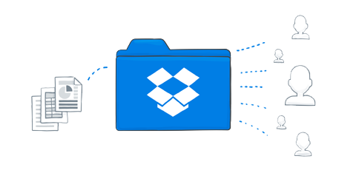
Challenges
Geographic Dispersal
Transferring large files associated with digital collections
Notes:
Another challenge created by working with people at a distance is the transferal of documents.
MD usually small enough to email Image files another matter: discs mailed, external harddrives exchanged
-Recently instituted the SCDL dropbox: proven to be very useful and expedient at passing docs both ways

Slide 10
Rewards
Providing access to significant and interesting historical records
Appreciation of collaborative partner
A chance to meet a lot of interesting and passionate people
Notes:
-Along with these challenges come a number of rewards that make the whole process worth while:
-First, providing access to significant and interesting historical records is rewarding unto its self
-The appreciation of the collaborating partners is very gratifying…often an experience with the SCDL is someone’s first foray into creating online collections. This task can be daunting and confusing. We demystify the process…and often they lack the expertise and resources to do it on their own…usually they are very appreciative of our efforts
-One of the greatest rewards: working with lots of interesting and passionate people

Slide 11
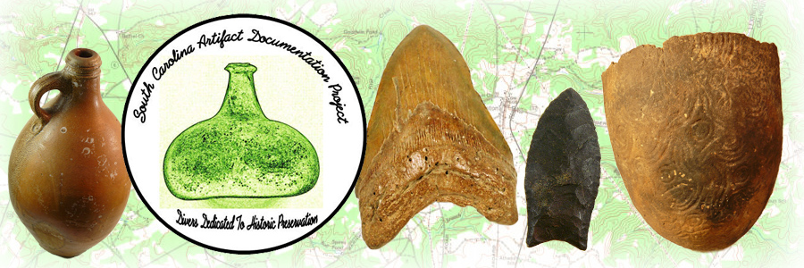
The South Carolina Artifact Documentation Project
Notes:
-one project that I think exemplifies Unique Collaborative Effort is South Carolina Artifact Doc. Project
-this is a collection of images documenting the artifact discoveries of hobby divers along the coast, in lakes and rivers of South Carolina.
-This project has turned out to be a particular favorite of mine…but…I was a bit worried about it in the beginning…

Slide 12
2 Hobby Divers
Involved in documenting artifacts found along the coast, lakes and rivers of South Carolina
Since mid 1970s
Desire to preserve and share the information they have collected
Collaborators
Notes:
-To create this collection I have been working with two men who I originally thought were on the Archeology Faculty or maybe professional archeologists…
-it turns out that professionally they actually work on oil rigs in the Gulf…
but they are primarily hobby divers who have been involved in documenting finds in the waters of South Carolina since the mid 1970s.
-They want to preserve and share the information that they have been gathering.

Slide 13
Metadata
Notes:
-Started with a number of phone calls to talk them through the creation of metadata
-this was before downloadable metadata sheet on the SCDL
-thought I’d done a pretty good job describing…what info we need, the various fields we might want to add…it sounded like they understood
-but when first metadata came in they had listed all the objects along the top and all the metadata fields on the left from top to bottom.
-no reason they would have known…
-never occurred to me…
-A few other things that initially made me a bit nervous about this collection…
For a while, even after we started to get good metadata from they kept referring to metadata as MEGADATA
Also…

Slide 14


Slide 15
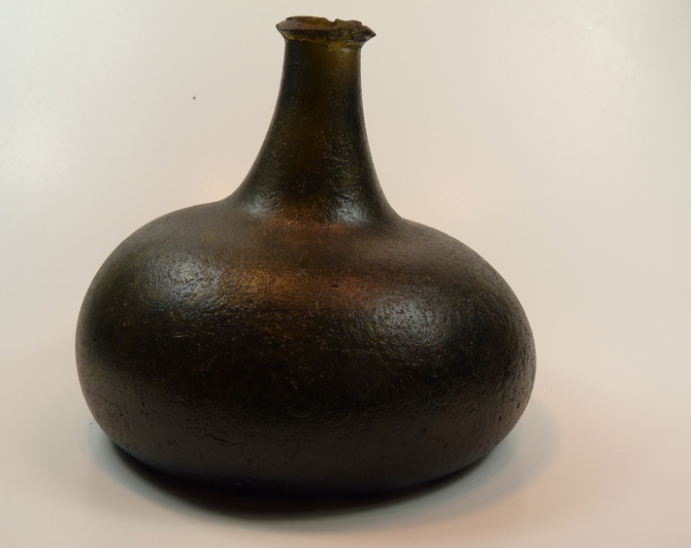
Notes:
Also, when I opened the first collection of images

Slide 16
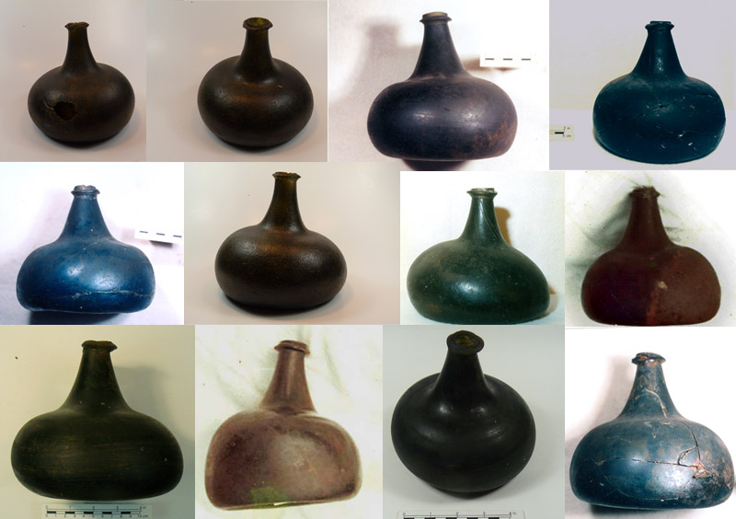

Slide 17
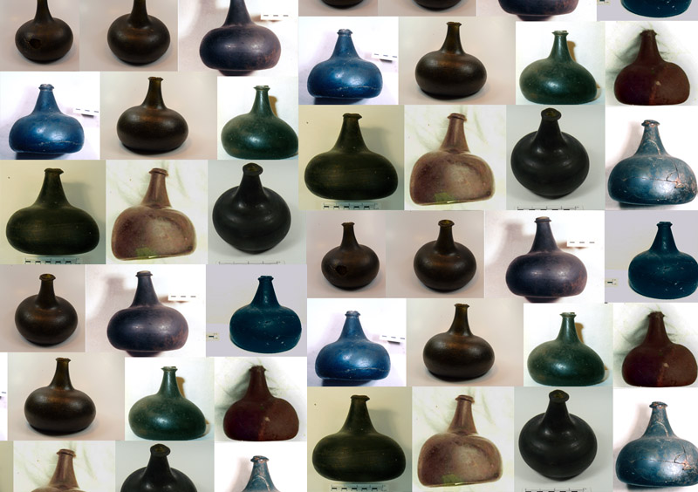
Notes:
-all the images were of nearly identical onion shaped bottles!
I really thought that the whole collection was going to be green bottles…
I was beginning to think we really made a mistake with this collection.
Luckily a colleague of mine in Digital Collections is a former archeologist and she brought in a book for me that identified the bottles and identified the subtleties that made them different
-Suddenly I realized this collection could be of real value to collectors, archeologists and collectors.
Plus – now I could identify a green bottle of Dutch origin over one made in Northern England in the 1600s

Slide 18
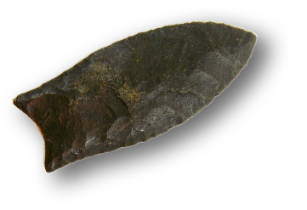
New metadata came in looking good
Complex metadata – compound objects showing multiple views
New collections of artifacts included different kids of objects
Looking Sharp!
Notes:
-ultimately we started getting new metadata and new collections of images and things were looking more hopeful.
-even though the metadata was quite complex with compound objects showing multiple views of the same artifact, these guys picked up on the process with impressive speed.
The new collections featured different objects like fossils, pottery, pipes and more…it was all starting to look good!

Slide 19
Participants often unreachable for periods of time
My assumptions of their backgrounds
My lack of knowledge about subject matter
Challenges
Notes:
-this project featured some collaborative challenges that needed to be overcome…
-participants were unreachable for periods of time when they were at sea
-I made some assumptions on their backgrounds which complicated the training
-my lack of knowledge of the subject matter really had to be overcome before I could fully appreciate the collection

Slide 20
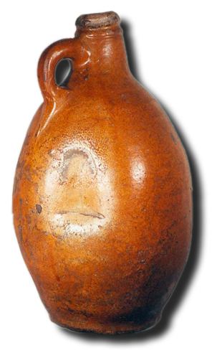
A chance to work with some really smart and interesting guys who are deeply passionate about their project
I have learned a lot in the process
Excited about the future development of this collection
Rewards
Notes:
Despite the challenges, the process has been very rewarding
-participants are very smart and interesting guys who are passionate about their collection and very appreciative of our efforts to bring it online
- I have learned a lot in the process
- Excited about this collection and looking forward to watching it grow

Slide 21
SCDL Project gives us an opportunity to explore collaboration on several levels
A chance to discuss collaboration with a wide variety of people
Unique challenges
Unique rewards
Conclusion
Notes:
The SCDL is a project that gives us the opportunity to explore collaboration on many levels
Most interesting it gives us a chance to discuss collaborating with a wide variety of people
This diversity offers unique challenges and rewards as well

Slide 22
Questions/Comments
John Quirk
South Carolina Digital Library
quirkj@mailbox.sc.edu
Jessica Short
Tennessee State Library and Archives
Jessica.Short@tn.gov
Ashley Knox
USC Digital Collections
knoxam@mailbox.sc.edu

