Slide 1
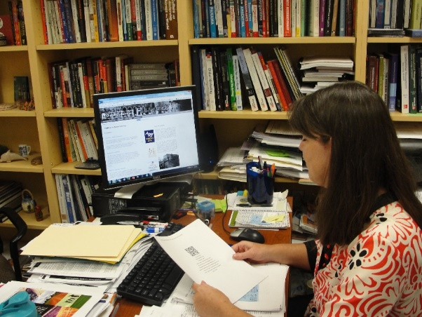
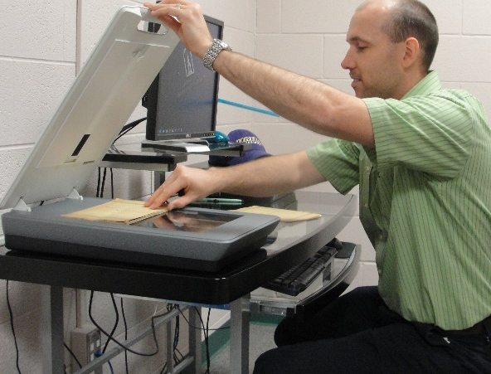
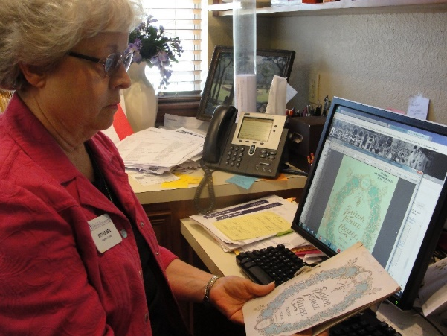
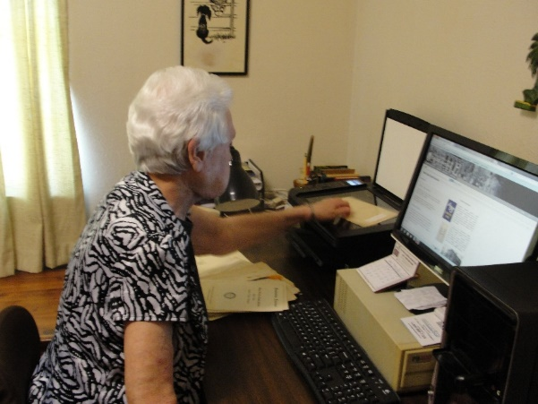
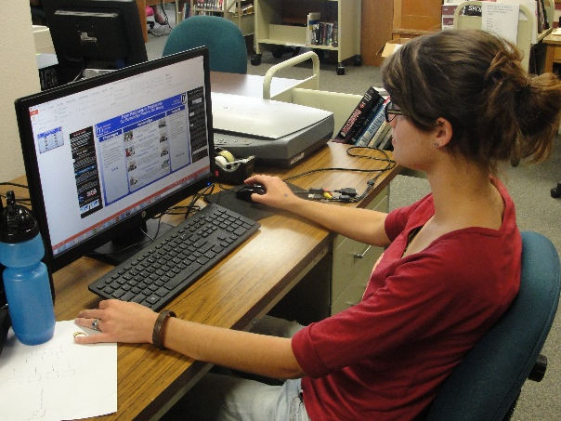
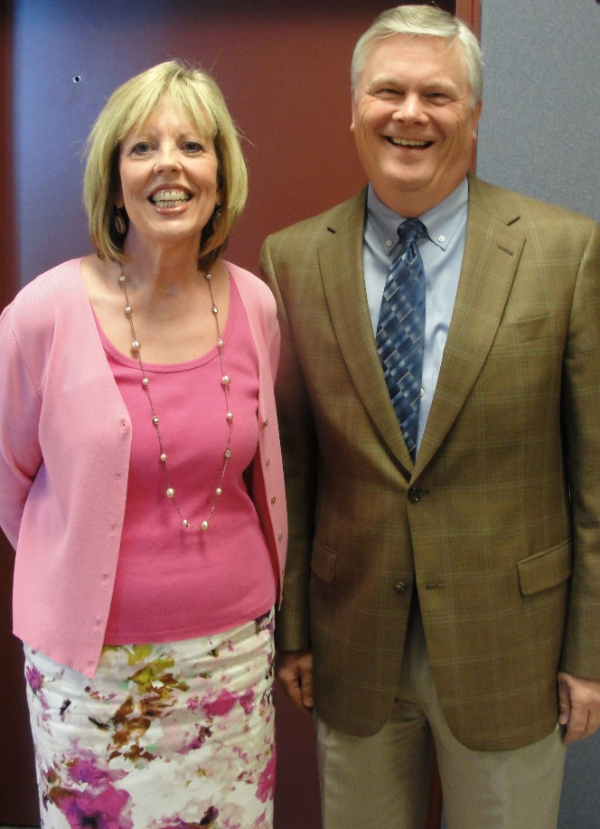
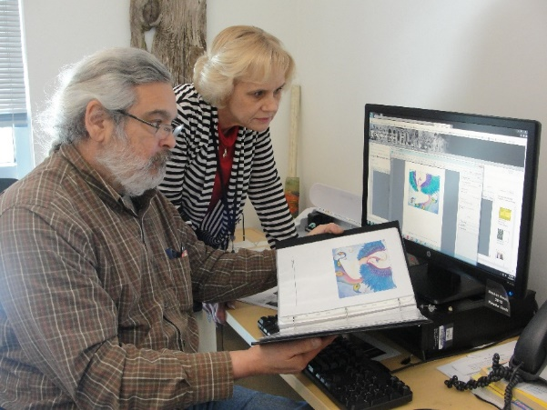
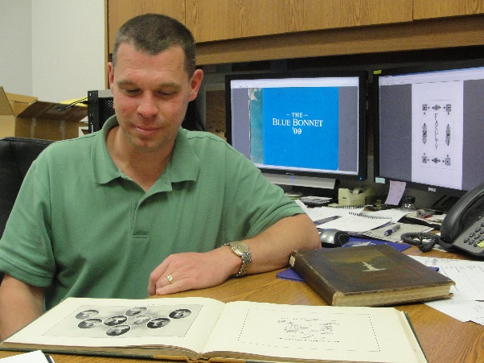
From Postcards to Practicums
Partnerships Preserve Our History
townsend memorial library
Anne Price, MLIS Kathy Harden, MLIS
University of Mary Hardin-Baylor
Public Services Librarian
Electronic Services Librarian
Challenges
Partnerships
Rewards
Selling our vision
Funding and buy-in
Submitting Faculty Development Grant proposal
Promoting and educating
Project management
Time management
Mastering the learning curve: scanning, software & metadata
Team of TWO
“Digitizing our MBA practicums will allow future students to access them more easily and it’s also much better for the environment than printing copies or having them book bound.”
-Dr. Michelle Reina
New library partnerships AND new friends
Preserving UMHB history
Creating new teaching aids
Creating research opportunities
Showcasing student projects, capstones, and dissertations
Graphic design opportunities for student assistants
Professional development
Dr. Michelle Reina
Assistant Professor
McLane College of Business
Bluebonnet Yearbooks
Postcards
Dr. Toby Coley
Assistant Professor
College of Humanities
“As curator of the university museum, I greatly advocate preserving the remarkable history of UMHB and providing ways to share it with current students, alumni, and the general public.”
-Betty Sue Beebe
Business Practicums
Dissertations
“Always eager to educate the public about my alma mater's history, I found this project an excellent vehicle …[to gather] the scattered bits of UMHB history into a centralized place accessible to not just alumni but the general public.“
-Kay Anderson
Betty Sue Beebe
UMHB Museum Curator
Class of 1961
Kay Anderson
Professor Emeritus
Class of 1963
Project Support
& Funding
College Catalogs
Pamphlets
Our B’s
“We are excited that our doctoral students will be able to share their research with other scholars and professionals in the field of education. Disseminating knowledge will also benefit our program and the university in terms of publicity and recruiting new students.”
-Christie Bledsoe, Ed.D.
Dr. Christie Bledsoe
College of Education
Sarah Coy, Ed.D. Candidate
Kateland Pricer
Graphic Design Assistant
Graphic Design Major
Art Shows - Senior Exhibitions
“The Digital Collections… preserve the capstone products of our [Art Department] graduates…and act as…teaching aids to help the next set of Senior Exhibition students understand requirements… and preview what is expected of quality senior portfolios.”
-Hershall Seals
Provost – Dr. Steve Oldham
Library Director - Denise Karimkhani
And… back to the future we go!!!
Hershall Seals
Professor & Department Chairperson
College of Visual & Performing Arts
Randy Yandell
Director- Graphic Services
Class of 1999

