Slide 1
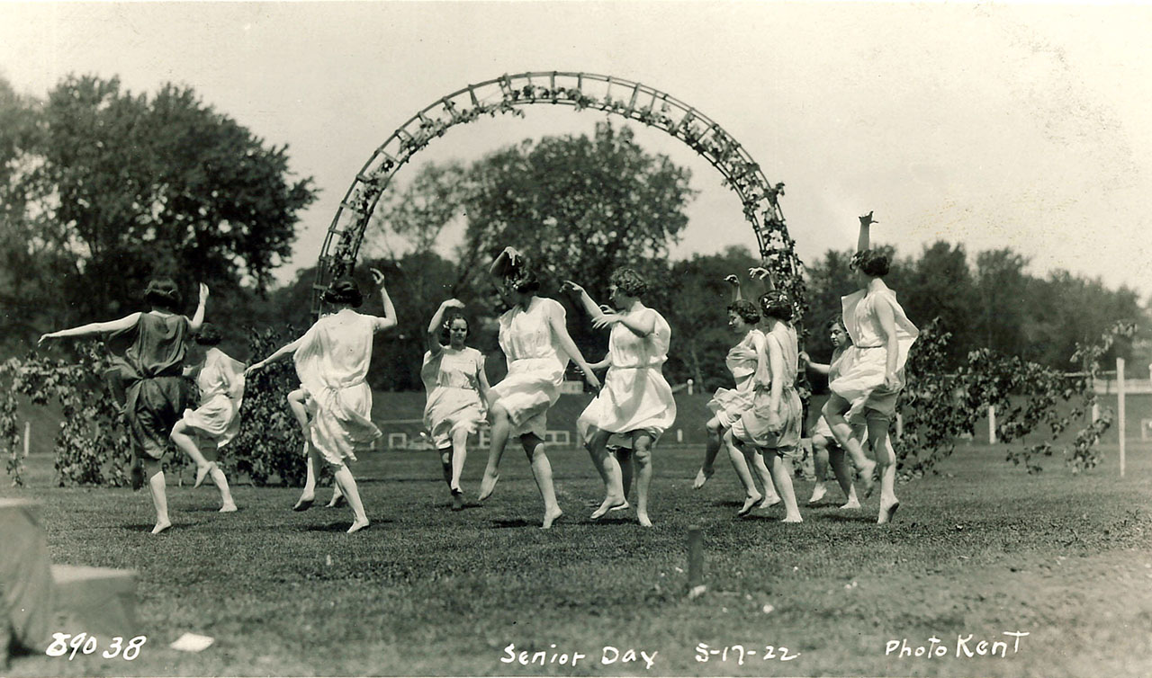
CONTENTdm Southern Users Group Meeting
May 21, 2014
Mark Anderson University of Iowa
Women dancing for Senior Day, The University of Iowa, May 17, 1922
http://digital.lib.uiowa.edu/cdm/ref/collection/ictcs/id/3271

Slide 2
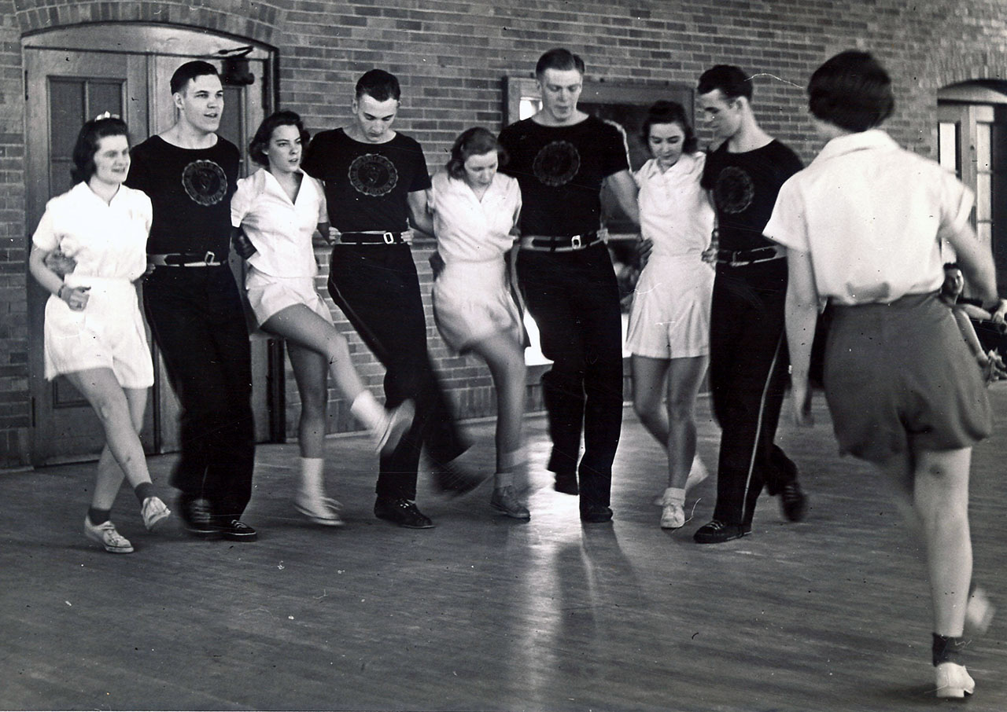
Kick it up a Notch: Advanced Upload Techniques, Features, and Tips-&-Tricks
Chorus line practicing kicks, The University of Iowa, 1940s
http://digital.lib.uiowa.edu/cdm/ref/collection/wpe/id/1127

Slide 3
Kick it up a Notch: Advanced Upload Techniques, Features, and Tips-&-Tricks for doing stuff to data before and after CONTENTdm
Excess acidity versus health, early 1940s
http://digital.lib.uiowa.edu/cdm/ref/collection/szathmary/id/282

Slide 4
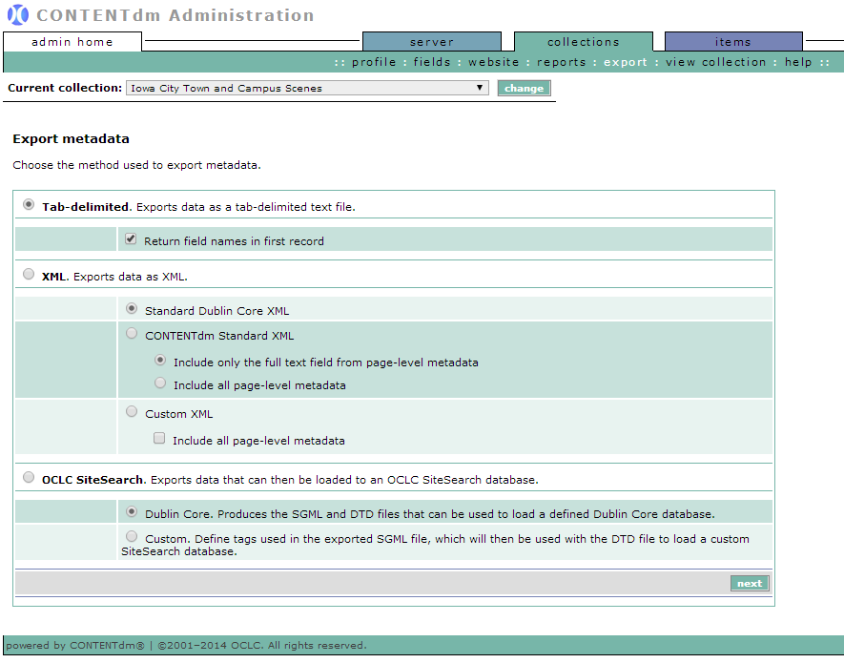
Exporting existing metadata in the Web Admin

Slide 5
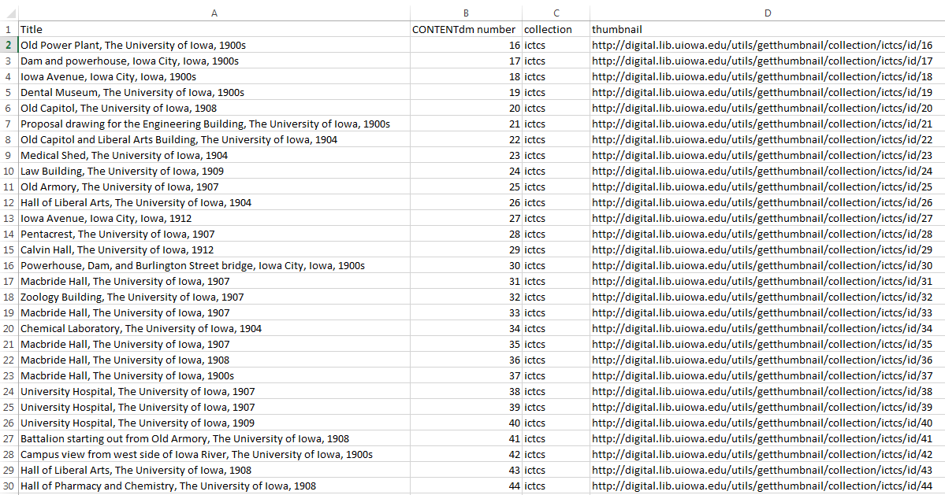
=CONCATENATE("http://digital.lib.uiowa.edu/utils/getthumbnail/collection/",C2,"/id/",B2)

Slide 6
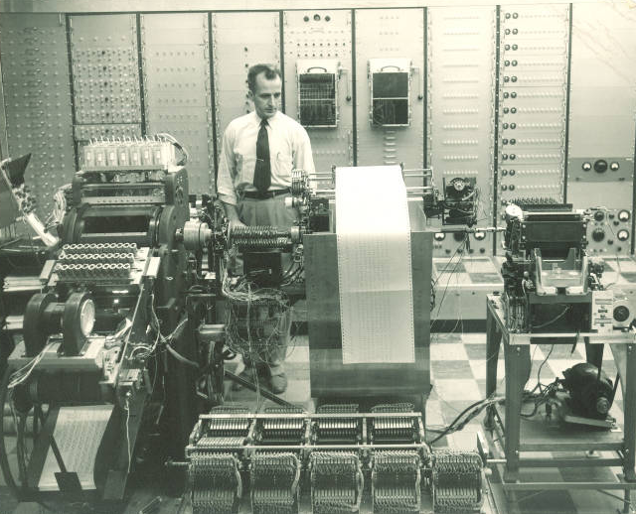
=CONCATENATE(B2,".tif")
Man working with a room-sized computer, The University of Iowa, 1950s
http://digital.lib.uiowa.edu/cdm/ref/collection/ictcs/id/8559

Slide 7
=CONCATENATE("31858060770355_",C2)
Man working with a room-sized computer, The University of Iowa, 1950s
http://digital.lib.uiowa.edu/cdm/ref/collection/ictcs/id/8559

Slide 8
=CONCATENATE("ren """,C2,""" """,D2,"""")
Man working with a room-sized computer, The University of Iowa, 1950s
http://digital.lib.uiowa.edu/cdm/ref/collection/ictcs/id/8559

Slide 9
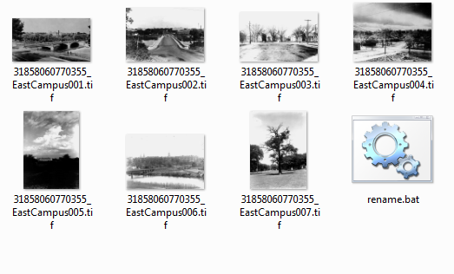
ren "EastCampus001.tif" "31858060770355_EastCampus001.tif"
Man working with a room-sized computer, The University of Iowa, 1950s
http://digital.lib.uiowa.edu/cdm/ref/collection/ictcs/id/8559

Slide 10
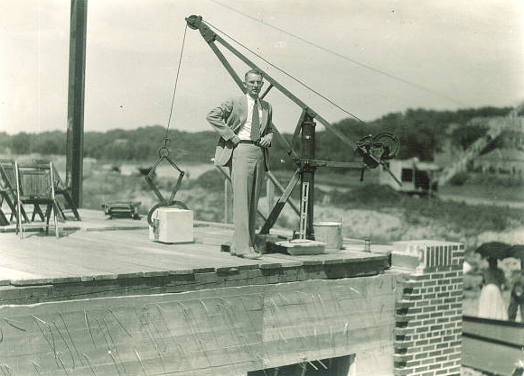
CONCATENATE and VLOOKUP for metadata prep
CONCATENATE
Swiss army knife of Excel
combining strings of text
Can be used for data editing
Even file renaming
VLOOKUP
The most powerful formula you’ve never used
pulling text from one sheet to another based on a matching element
Makes some manual data entry automated
When that data exists somewhere else
laying of the Art Building cornerstone, The University of Iowa, June 2, 1934
http://digital.lib.uiowa.edu/cdm/ref/collection/ictcs/id/13955

Slide 11
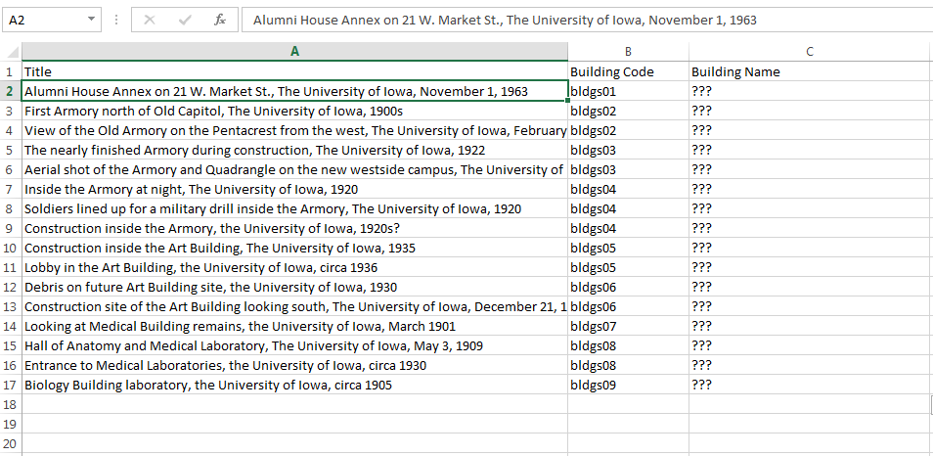
Code but not corresponding data

Slide 12
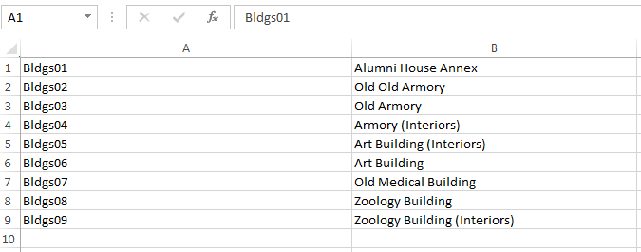
But match exists in another sheet

Slide 13
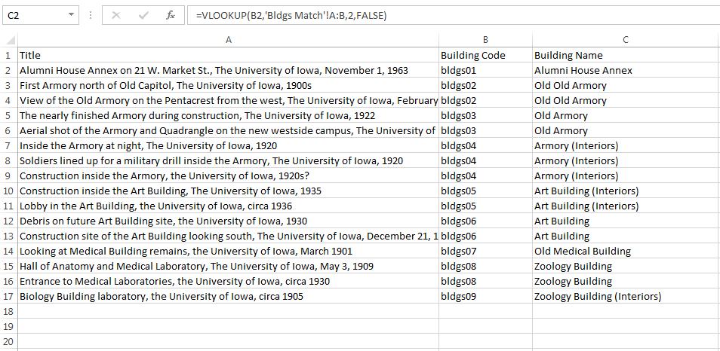
=VLOOKUP(B2,'Bldgs Match'!A:B,2,FALSE)

Slide 14
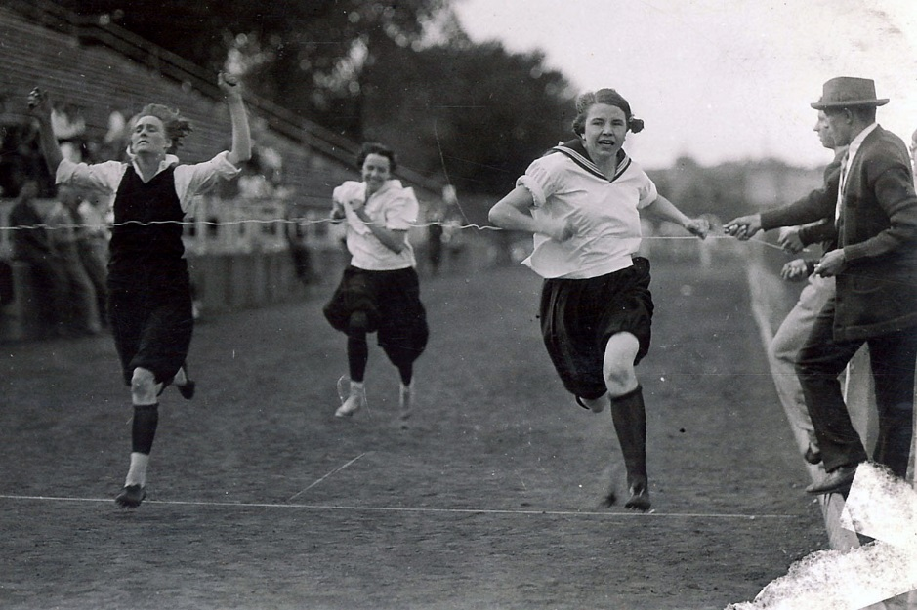
ASAP Utilities
http://www.asap-utilities.com/
Point and click for complicated editing functions
Free full edition trial or home/student edition
No 64-bit Excel (yet)
Race to the finish line, The University of Iowa, 1910s
http://digital.lib.uiowa.edu/cdm/ref/collection/ictcs/id/6431

Slide 15
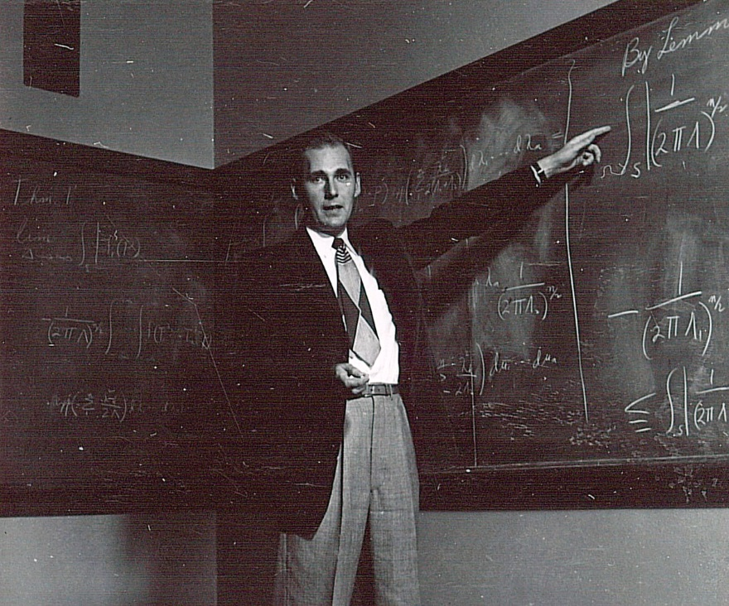
http://www.slideshare.net/MarkAnderson44/cdm-southern-presentation-2014
Thank you!
Physics instructor pointing at an equation on chalkboard, The University of Iowa, 1940s
http://digital.lib.uiowa.edu/cdm/ref/collection/ictcs/id/10975

